Slide 1


GreenCircle Certified
Database Project
Wireframes and User Stories

Slide 2

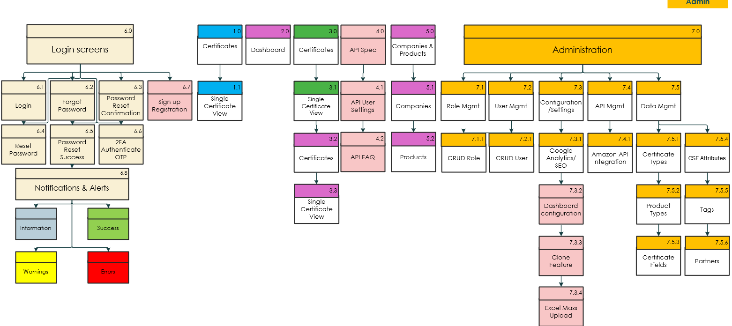
GreenCircle Certified Database Site Map
Notes:
CRUD: [Create, Read, Update, Delete] – Wireframes include the details of the screens.
Notifications & Alerts: Color-coded: Green for success, Red for errors, Yellow for warnings, Blue/gray for info)
Sign-up Registration will be included but hidden and disabled for all users except the admin.
Assumptions:
Certificate List 1.0 is a different page than Certificates 3.0.
Admin will have the ability to Add, Edit or Delete a Certificate, Company, Products, Users, Certificate Type, Product Types and Tags.

Slide 3

User Stories

Slide 4
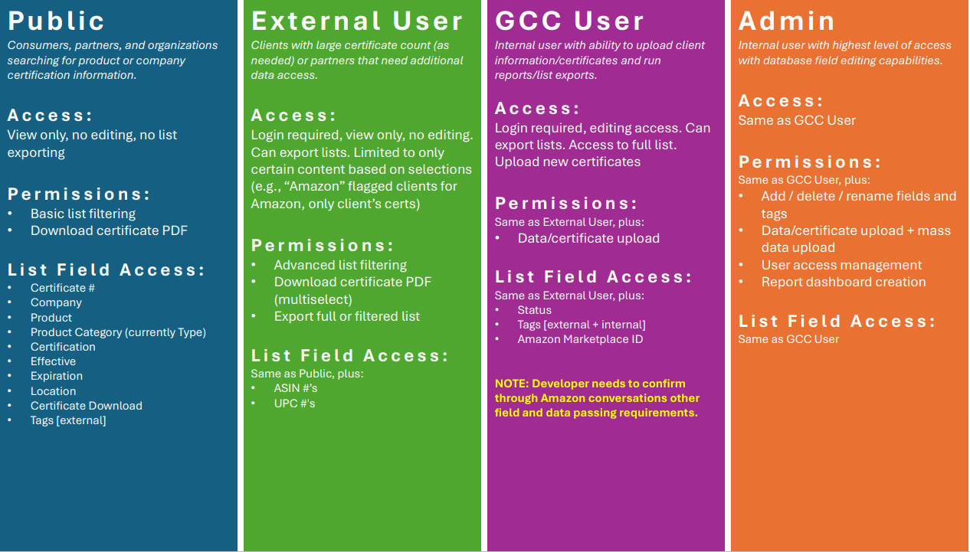
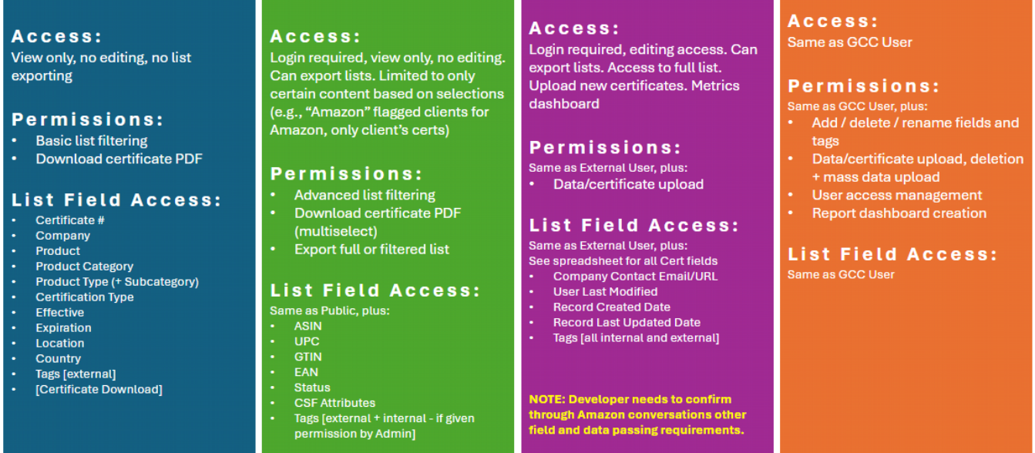
GCC: User Roles

Slide 5
User Stories – Public User
Access & Visibility
As a public user, I want to browse publicly available active certifications so that I can verify product compliance.
As a public user, I want to access certifications without needing to log in so that I can quickly find information.
As a public user, I want to view only non-confidential certifications so that I do not access restricted data.
Search & Filtering
As a public user, I want to search for certifications by certificate number, Certification Type, Product Categories, Company, Country or Tags so that I can verify compliance.
As a public user, I want to filter certifications by product, product type / category, and product subcategory so that I can narrow my search. Product Categories is the only section that has multiple levels.
As a public user, I want to see the most recently issued certifications and those with upcoming expiration dates.
Viewing & Downloading Certifications
As a public user, I want to view details of a certification so that I can verify product compliance.
As a public user, I want to view and download single certifications so that I can reference them offline.

Slide 6
User Stories – Public User
Tagging & Classification
As a public user, I want to see tags assigned to certifications so that I can understand additional certification classifications.
As a public user, I want to search for certifications by tag so that I can find related certificates.
Data Access & Security
As a public user, I want to access only publicly available information so that confidential data remains protected.

Slide 7
User Stories – External User (Client)
Access & Visibility
As an external user, I want to log in securely so that I can access my company's certification data.
As an external user, I want to see all certifications related to my company so that I can track compliance.
As an external user, I want to ensure that I cannot see certifications from other companies so that my access is restricted to my organization.
As an external user, I want my permissions to be pre-defined by an admin so that I only access the relevant data.
As an external user, I want to be able to filter my certifications based on status (active, expired, pending) so that I can quickly find relevant information.
Search & Filtering
As an external user, I want to search for certifications within my company so that I can locate specific records.
As an external user, I want to filter certifications by type, category, and subcategory so that I can narrow down the results.
As an external user, I want to sort certifications by expiration date so that I can prioritize renewals.
As an external user, I want to search certifications by product name so that I can verify specific items.
As an external user, I want to filter by location, tags, and other available filter options based on their intended search purpose.
As an external user, I want to export my company's certification data into Excel so that I can use it for reporting and documentation. purposes.

Slide 8
User Stories – External User (Client)
Viewing & Downloading Certifications
As an external user, I want to view details of each certification so that I can verify product compliance.
As an external user, I want to download certificates in multi-select format so that I can share them with my stakeholders.
As an external user, I want to check the expiration date of a certification so that I can ensure timely renewals.
Tagging & Classification
As an external user, I want to see assigned tags on certifications so that I can categorize data effectively.
As an external user, I want to filter certifications based on assigned tags so that I can group relevant products together.
As an external user, I want to view which products are associated with a specific certification so that I can understand product compliance.
Data Access & Security
As an external user, I want my access restricted to only my company's data so that I do not see competitors' certifications.
As an external user, I want to log out securely so that I can prevent unauthorized access to my account.
As an external user, I want my account to be managed by an admin so that permissions are properly controlled.

Slide 9
User Stories – External User (Partner)
Access & Visibility
As an external user, I want to log in securely so that I can access my program's certification data.
As an external user, I want to see all certifications related to my program so that I can track compliance.
As an external user, I want to ensure that I cannot see certifications from other companies or programs so that my access is restricted to my program.
As an external user, I want my permissions to be pre-defined by an admin so that I only access the relevant data.
As an external user, I want to be able to filter my certifications based on status (active, expired, pending) so that I can quickly find relevant information.
Search & Filtering
As an external user, I want to search for certifications within my program so that I can locate specific records.
As an external user, I want to filter certifications by type, category, and subcategory so that I can narrow down the results.
As an external user, I want to search certifications by product name so that I can verify specific items.
As an external user, I want to filter by location, tags, and other available columns to filter options based on their intended search purpose.
As an external user, I want to export my program certification data into Excel so that I can use it for reporting and documentation purposes.
Partners (where they will have access across companies for products that are part of their program only – for example Amazon CPF clients/certs)

Slide 10
User Stories – External User (Partner)
Viewing & Downloading Certifications
As an external user, I want to view details of each certification so that I can verify product compliance.
As an external user, I want to download certificates in multi-select format so that I can share them with my stakeholders.
As an external user, I want to check the expiration date of a certification so that I can validate certification period.
Tagging & Classification
As an external user, I want to see assigned tags on certifications so that I can categorize data effectively.
As an external user, I want to filter certifications based on assigned tags so that I can group relevant products together.
As an external user, I want to view which products are associated with a specific certification so that I can understand product compliance.
Data Access & Security
As an external user, I want my access restricted to only my program’s data so that I do not see competitors’ or restricted certifications.
As an external user, I want to log out securely so that I can prevent unauthorized access to my account.
As an external user, I want my account to be managed by an admin so that permissions are properly controlled.

Slide 11
User Stories – GCC Analyst
Access & Visibility
As an analyst, I want to log in securely so that I can access certification data.
As an analyst, I want to see all certifications so that I can manage records effectively.
As an analyst, I want my access restricted to only my assigned role so that I do not see unauthorized data.
As an analyst, I want to view dashboard reports so that I can track data and trends.
Search & Filtering
As an analyst, I want to filter certifications by all fields so that I can generate reports and narrow by results based on my search needs.
As an analyst, I want to sort certifications by modification date so that I can easily find a recent certificate that may need additional edits.
Viewing & Downloading Certifications
As an analyst, I want to view detailed certification records so that I can ensure compliance accuracy.
As an analyst, I want to download certification data in bulk so that I can conduct offline analysis.
As an analyst, , I want to see the history of modifications for a certification so that I can track changes.
As an analyst, I want to download multiple certifications based on search criteria to view or save in bulk.
As an analyst, I want to be able to add and edit certificates, cert status, products, and companies.

Slide 12
User Stories – GCC Analyst
Tagging & Classification
As an analyst, I want to assign tags to certifications so that I can classify them effectively.
As an analyst, I want to edit or remove assigned tags so that I can keep records up to date.
Data Access & Security
As an analyst, I want my access to be restricted based on admin settings so that I only see relevant data and don’t make unintended changes.
As an analyst, I want to track user activity logs so that I can review who made modifications to records.

Slide 13
User Stories - Admin
Access & Visibility
As an admin, I want to manage user roles and permissions so that I can control access levels.
As an admin, I want to view all certifications across all companies so that I can oversee compliance.
As an admin, I want to create, edit, and delete user accounts so that I can manage system access.
Search & Filtering
As an admin, I want to search certifications across all companies so that I can manage records efficiently.
As an admin, I want to filter any of the certificate fields so that I can oversee compliance trends.
As an admin, I want to sort certifications by the last modified date so that I can track updates.
As an admin, I want to be able to set the certificate status (active, expired, pending).
Viewing & Downloading Certifications
As an admin, I want to view detailed certification records across the entire platform so that I can manage data integrity.
As an admin, I want to export all certification data so that I can generate system-wide reports.
As an admin, I want to track certification history and changes so that I can audit modifications.

Slide 14
User Stories - Admin
Tagging & Classification
As an admin, I want to create, edit, and remove tags so that I can organize certifications effectively.
As an admin, I want to standardize tags across the platform so that users have consistent classification options.
As an admin, I’m the only role that has the ability to edit product categories, product types and subcategories, certification types, CSF attributes.
As an admin, I have the ability to add new fields to Certificate page.
Data Access & Security
As an admin, I want to enforce multi-factor authentication so that system security is enhanced.
As an admin, I want to track user activity logs so that I can monitor system usage.
As an admin, I want the ability to add a new field to certificates.
As an admin, I want to restrict access to certain certifications so that only authorized users can view them.
As an admin, I want to integrate API connections with third-party platforms so that external vendors can securely access data.
As an admin, I want the ability to add, update or delete data for Companies, product types, certificate types, partners, CSF Attributes, and Tags
As an admin, I want the system back-end to handle certificate numbering with manual override option available if needed.
As an admin, I want the system back-end to manage what appears in the public database based on active status.

Slide 15
Login & Notification Screens

Slide 16
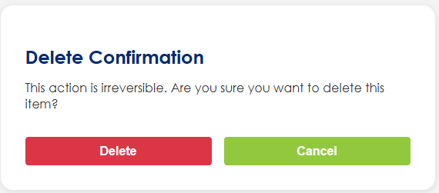
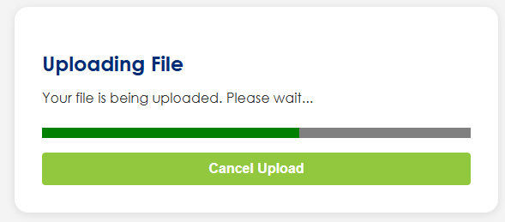
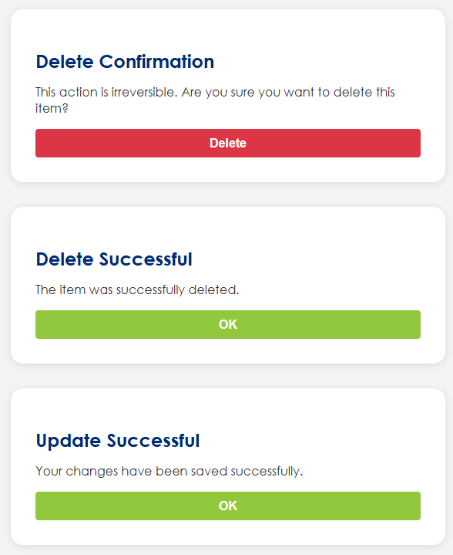
Notifications & Alerts
Notes:
Examples of notification and alerts.
We will need to identify all instances of where notifications and alerts need to occur.
Color-coded:
  Green for success
  Red for errors
  Yellow for warnings on toast messages.
  Blue/gray for info(navy blue)

Slide 17
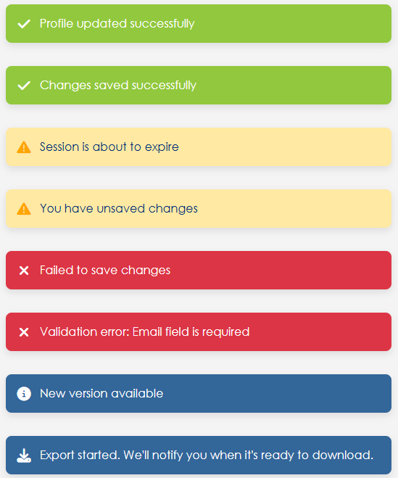
Notifications & Alerts
Notes:
Examples of notification and alerts.
We will need to identify all instances of where notifications and alerts need to occur.
Color-coded:
  Green for success
  Red for errors
  Yellow for warnings
  Blue/gray for info(navy blue)
Notes:
Primary Colors
Green Primary: #92C83E (Used for success actions, add buttons, positive feedback)
Green Secondary: #447638 (Darker green variant)
Blue Primary: #00AEEF (Used for primary actions, navigation links, focus states)
Blue Dark: #002B76 (Used for headers, titles, dark text)
Functional Colors
Success: #92C83E (Same as Green Primary)
Error/Warning: #ff5252 (Red for errors and destructive actions)
Warning Background: #FFE9A3 (Light yellow for warning notifications)
Info: #336699 (For informational messages)

Slide 18
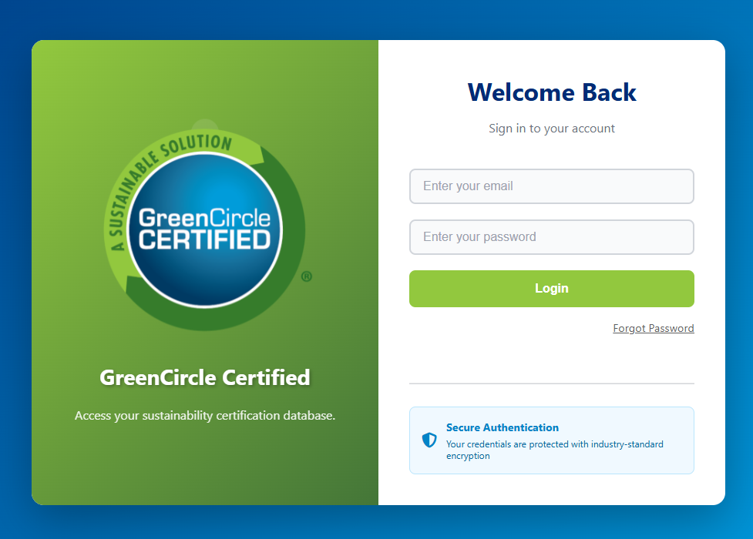
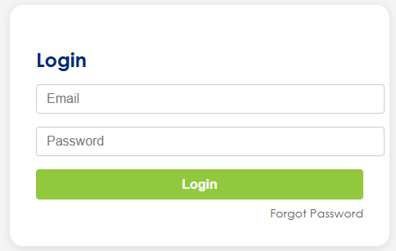
Wireframe Notes – 6.1 – Login
Login Screen
Username/Email and Password fields
Login button
"Forgot Password" link
The login screen has been updated. If this UI is preferred. We can update the remaining login screens to match.

Slide 19
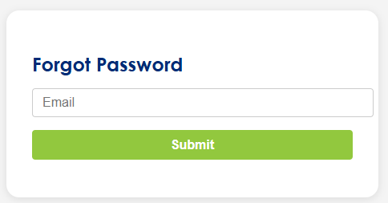
Wireframe Notes – 6.2 – Forgot Password
Forgot Password Screen
Input: Email
Submit button

Slide 20
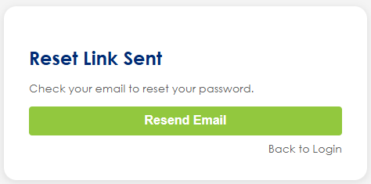
Wireframe Notes – 6.3 – Password Reset Confirmation
Password Reset Confirmation Screen (Email Sent)
Confirmation that an email was sent
Option to resend
Option to go back to Login

Slide 21
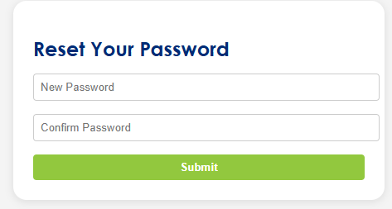
Wireframe Notes – 6.4 – Reset Password
Reset Password Screen
Accessed via email link (usually with token)
New Password + Confirm Password
Submit button

Slide 22
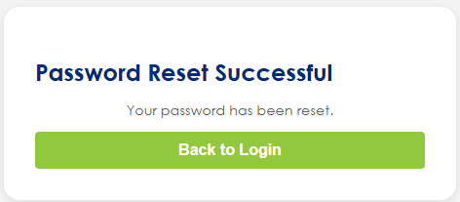
Wireframe Notes – 6.5 – Password Reset Successful
Password Reset Success Screen
Message: "Your password has been reset"
Button to go back to Login

Slide 23
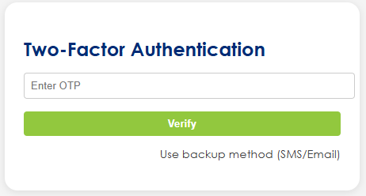
Wireframe Notes – 6.6 – 2FA Authenticate OTP
Two-Factor Authentication (2FA) Screen
Prompt for OTP or code from authenticator app
Backup methods (e.g., SMS, email)

Slide 24
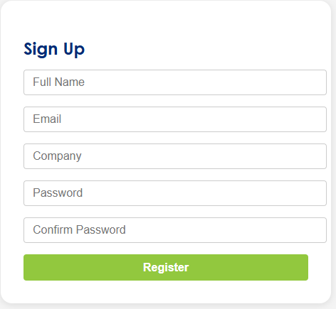
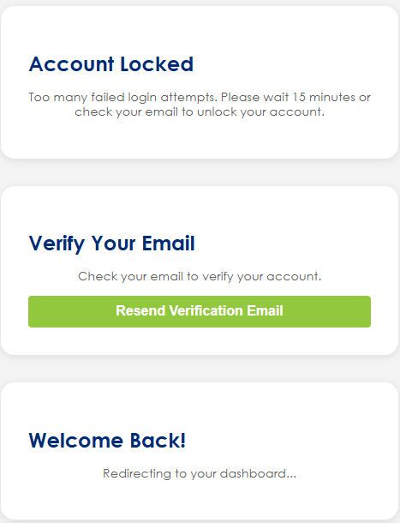
Wireframe Notes – 6.7 – Sign-up Registration (out of Scope)
Sign Up / Registration Screen (Disabled/Hidden)
If account creation is allowed in the future
Additional Screens:
Account Lock/Too Many Attempts Screen
Inform user of lockout
Time remaining or action to unlock (e.g., via email)
Email Verification Screen (Post Sign-up)
“Check your email to verify your account”
Resend Verification Email Screen
In case the user didn’t receive the initial verification
Login Success Redirect / Dashboard Screen
After login, redirect to home, dashboard, or intended page

Slide 25
Wireframes

Slide 26
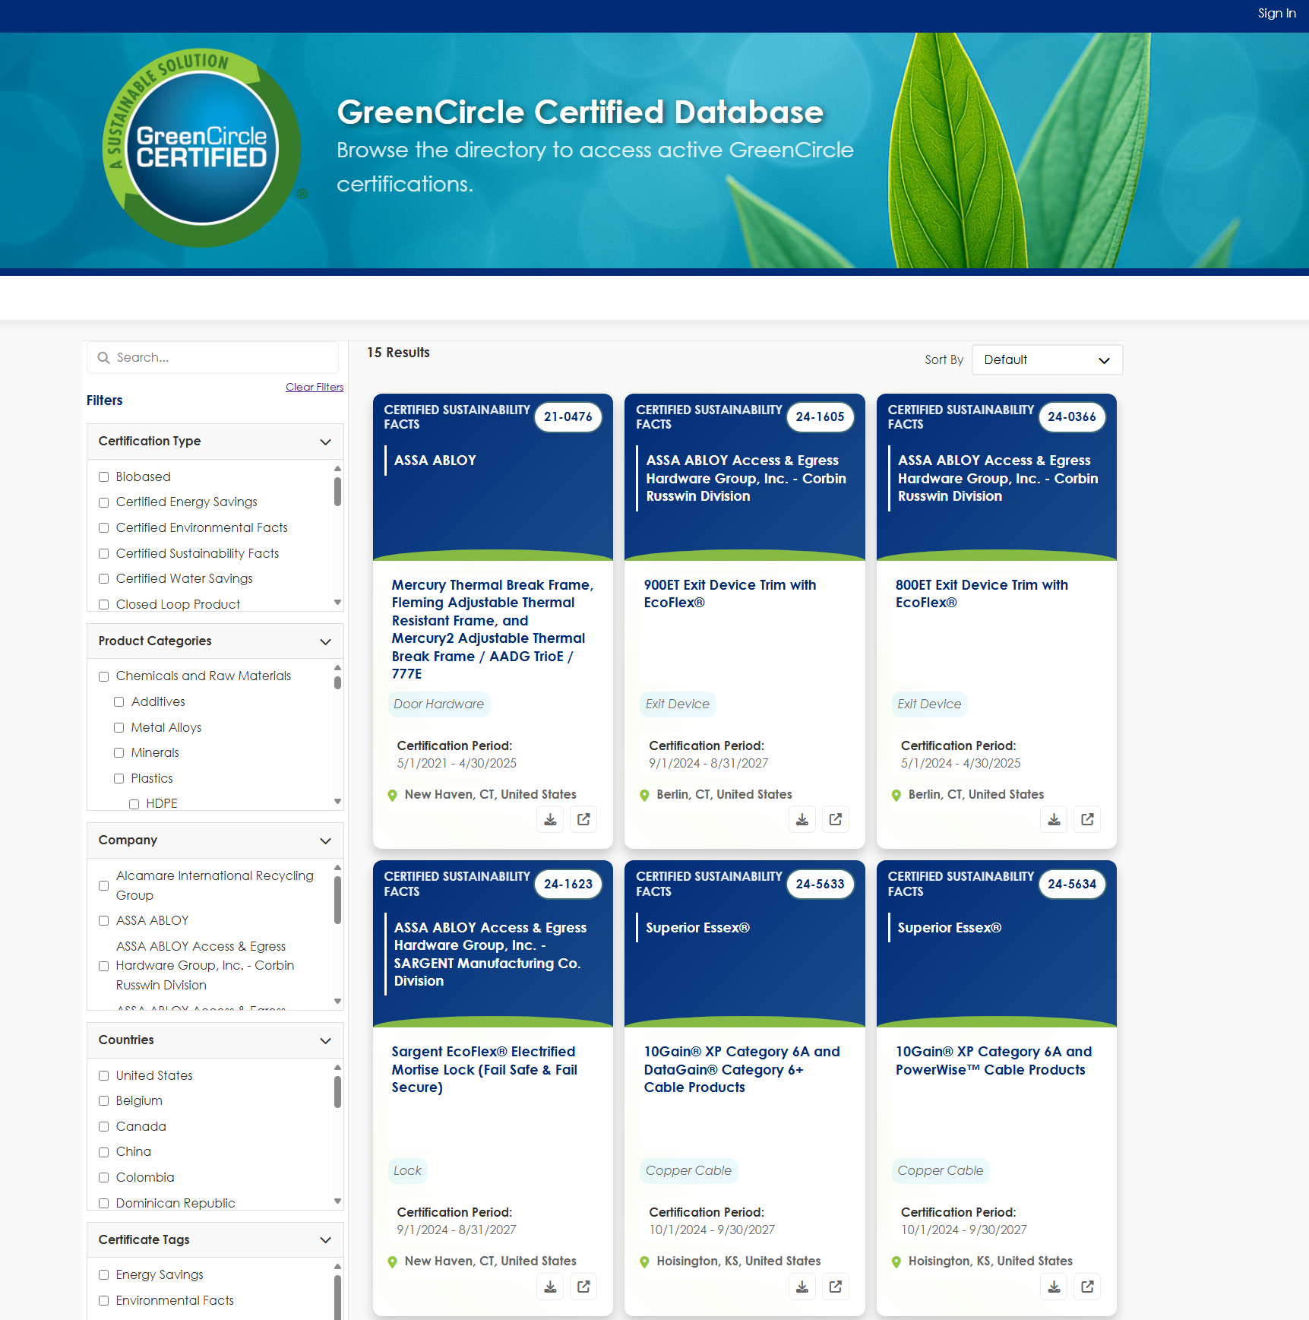
Wireframe Notes – 1.0 - Certificates
Fields not included on Tile:
Company Contact Email/URL
Product Category
Product Subcategory
Tags
Filter Sections
Certification Type
Product Categories (multiple level filtering)
Company
Countries
Certificate Tags
Additional
Disclaimer is in the footer instead of the header an only visible on this page and single certificate view for public view.
New subtext has been added to the header.

Slide 27
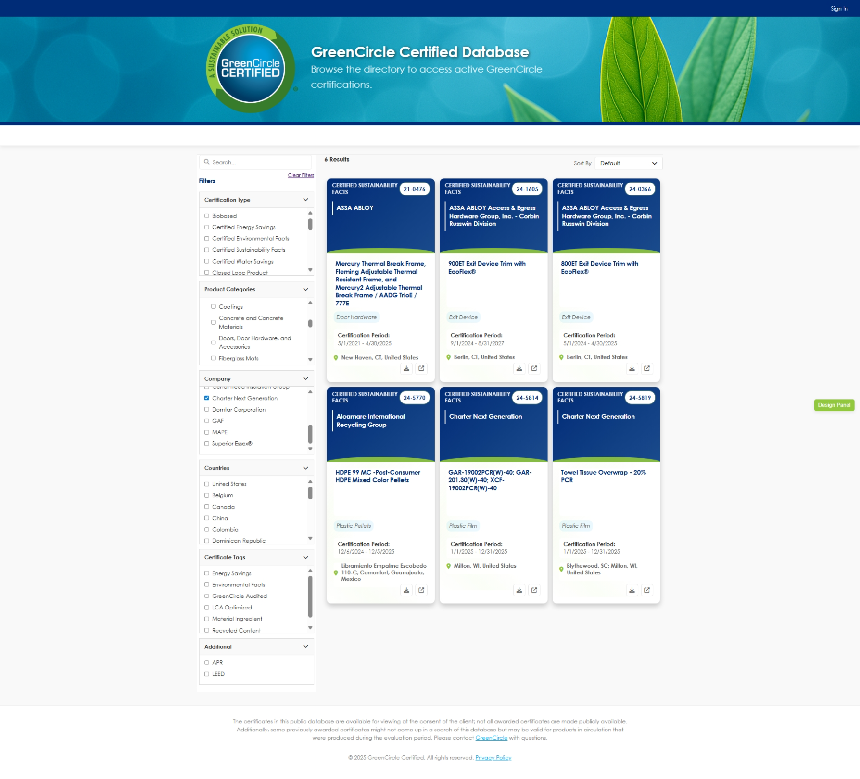
Wireframe Notes – 1.0 - Certificates
Zoomed out to show full page.

Slide 28
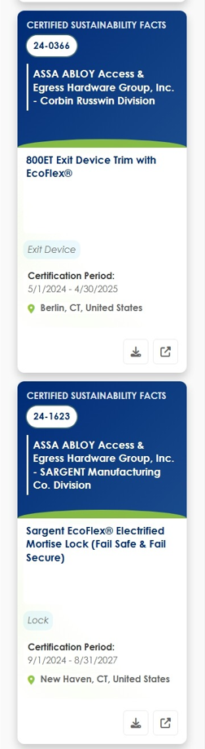
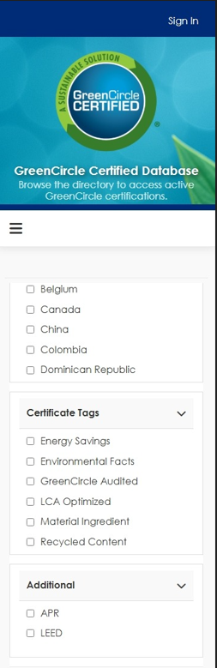
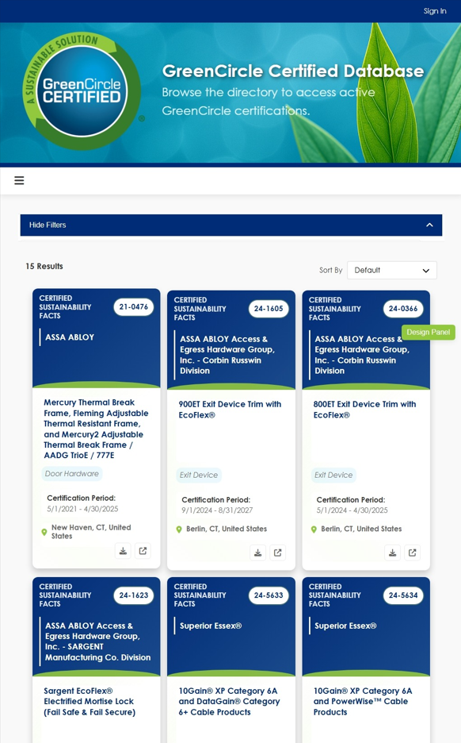
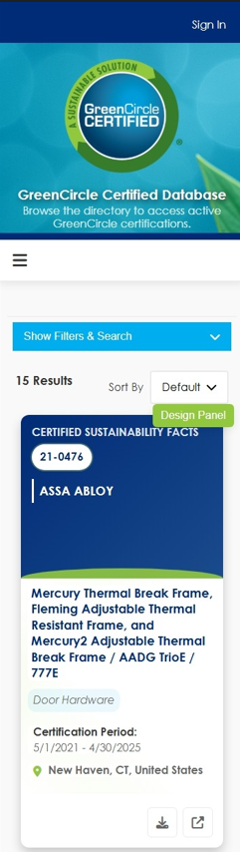
Wireframe Notes – 1.0 – Certificates – Mobile/Tablet Views

Slide 29
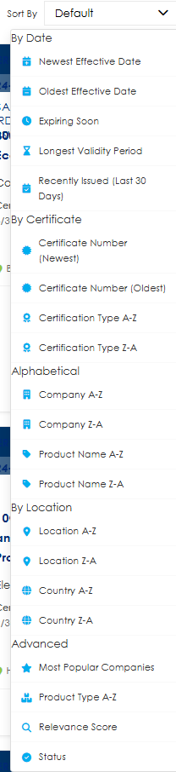
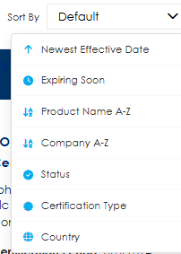
Wireframe Notes – 1.0 - Certificates
Sort by Options (Confirm Final List with GCC)
Sort By Options
By Date
Newest Effective Date
Oldest Effective Date
Expiring Soon
Longest Validity Period
Recently Issued (Last 30 Days)
By Certificate
Certificate Number (Newest)
Certificate Number (Oldest)
Certification Type A-Z
Certification Type Z-A
Alphabetical
Company A-Z
Company Z-A
Product Name A-Z
Product Name Z-A
By Location
Location A-Z
Location Z-A
Country A-Z
Country Z-A
Advanced
Most Popular Companies
Product Type A-Z
Relevance Score
Status
Requirement: Ability to sort tiles on all Public database columns (Certificate #, Certification Type, Effective Date, Expiration Date, Company, Company Contact Email/URL, Product Name, Product Category, Product Type, Product Type Subcategory, Location, Country, External Tag) (Striked out does not need sorting)

Slide 30
Wireframe Notes – 1.0 - Certificate List (Public Page)
This is the landing page (https://db.greencirclecertified.com/certificate) on the current website.
Clicking anywhere on the tile of a certificate will take the user to the Certificate View, separate page that opens into a new window, that shows details about the selected certificate.
Search bar, autocomplete suggestions, filters on search terms within results, mobile compatibility, and the ability to narrow down search results based on specific criteria within categories, allowing users to easily find specific content on a site.
Ability to sort tiles on all Public database columns (Certificate #, Certification Type, Effective Date, Expiration Date, Company, Company Contact Email/URL, Product Name, Product Category, Product Type, Product Type Subcategory, Location, Country, External Tag) (Striked out does not need sorting)
Ability to filter by search categories
All Public data fields to be displayed: Certificate #, Certification Type, Effective Date, Expiration Date, Company, Company Contact Email/URL, Product Name, Product Category, Product Type, Product Type Subcategory, Location, Country, External Tag
Need to make sure a unique URL can be created based on search criteria so clients can directly link to DB with just listing of their certifications (SCS does this as you add search criteria). Unique URL per Certification View for direct cert access.
Ability to view # Results
Ability to Clear filters
Certification download capability. Ability to download certificate directly from tile via download icon.
*Wishlist: The ability to load the table as a user scrolls Lazy loading, rather than have the page control.
Notes:
I don't understand what this means - on https://www.greencirclecertified.com/ you select Certified Product Database to get to this location
If you are talking about how someone signs in that would be Sign In. We should not need to say Go to Portal anymore
What are available sort options?

Slide 31
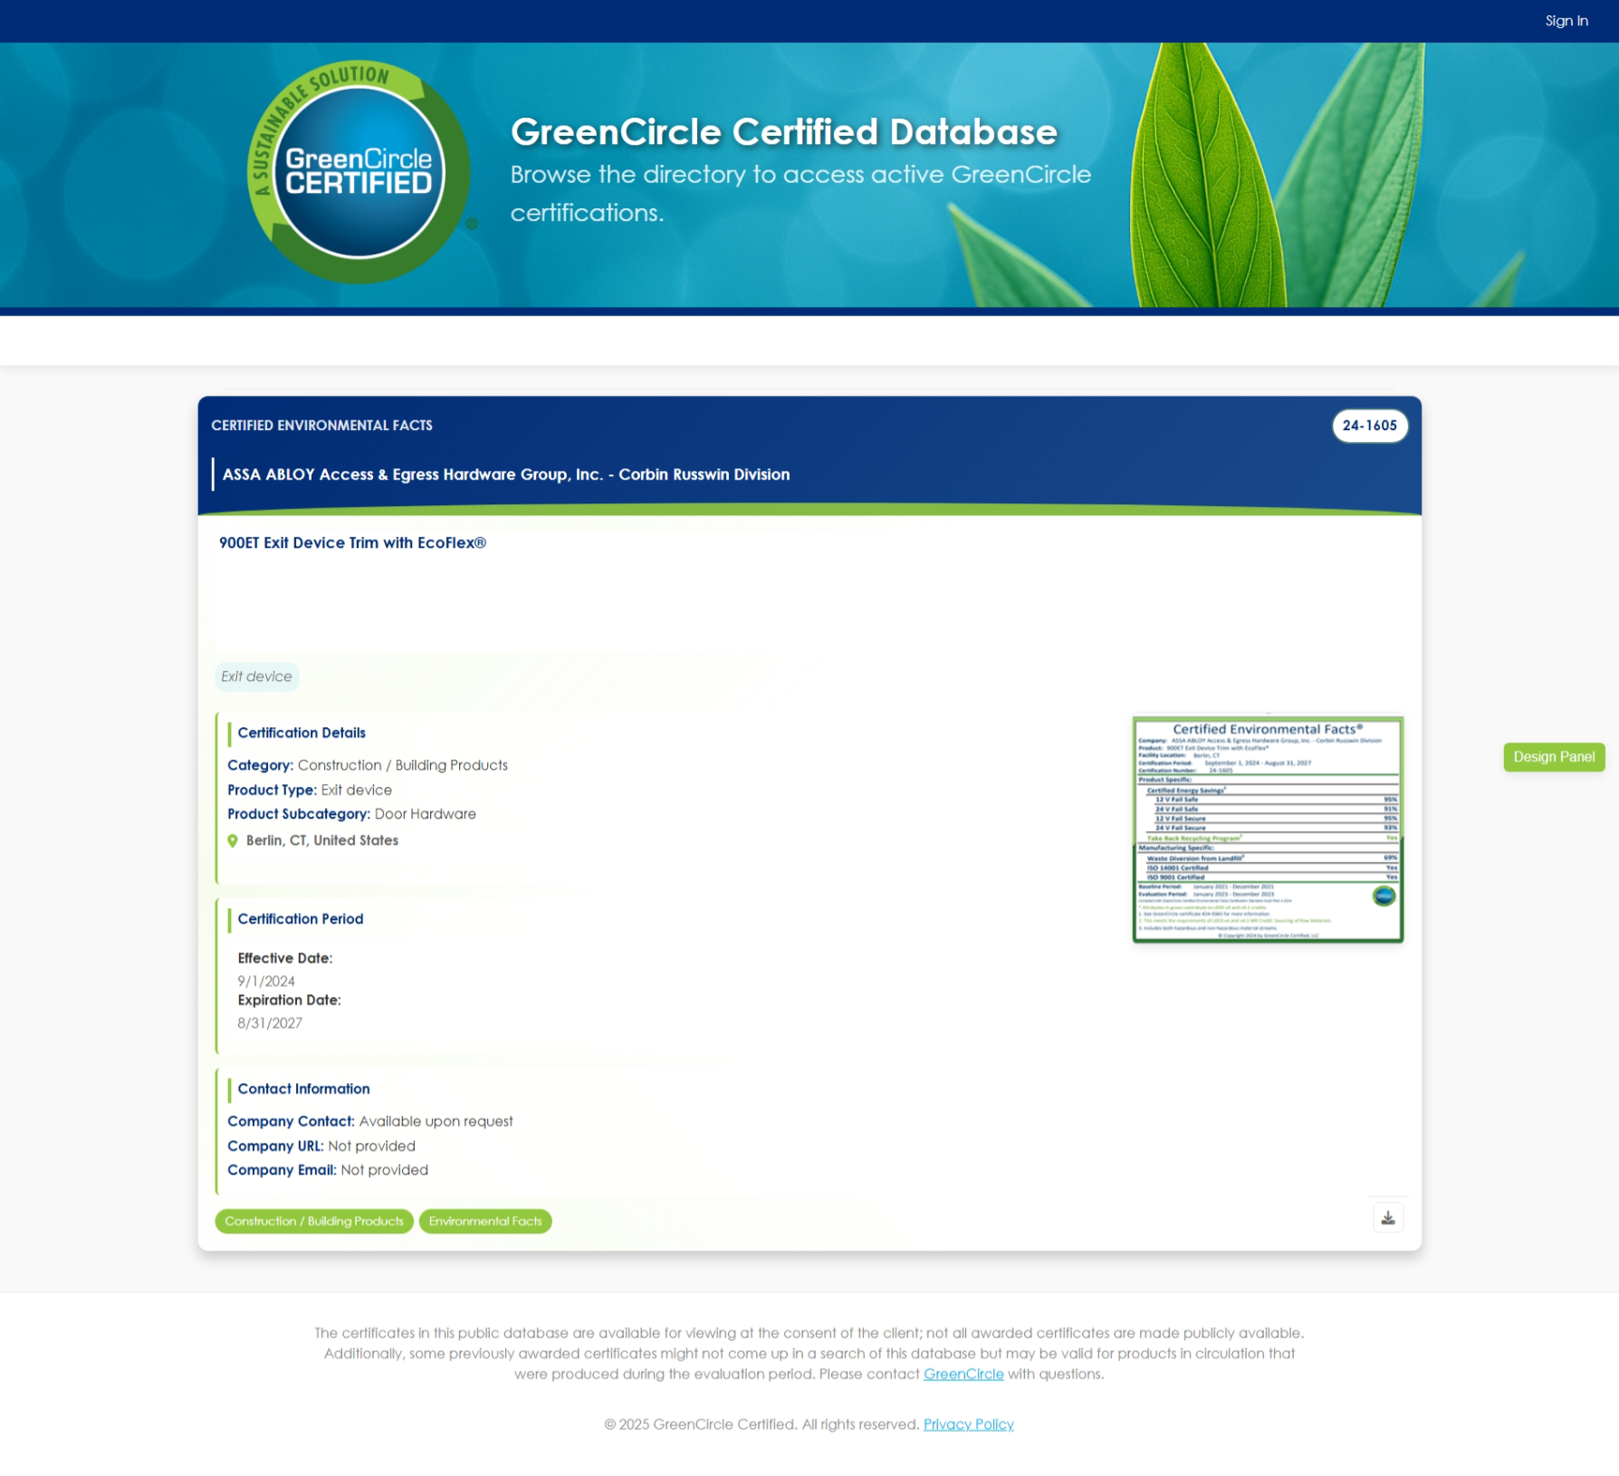
Wireframe Notes – 1.1 – Single Certificate View
Notes:
This is the Single Cert View for Public Users.
Ability to view all Public data fields for the selected Single Certificate.
Ability to Download the Certificate.
Certificate view will load into a new tab.
Notes:
View Certificate: Could we have company name and product name at the top - should be designed to be visually appealing and more prominent then the rest.
Either way don't want it to say View Certificate
These are not editable in this view I would not make the fields look like they are text field boxes for editing should be visually appealing
Certificate #
format: add X: format should be: XX-XXXX
If someone tries to manually enter and number exists should have a popup box to confirm if still use or change
Switch Product Name and Company order and put all Product details in same column
Product Type Subcategory: Most will not have subcategory - will it be hidden or just be blank?
Placeholder Image: Make this thumbnail image of the actual certification. Include a preview option to view cert full screen in webpage. Also have download button to download cert (you have just make sure it's closer to the image of cert)
This is not used often but when it is it should appear -- they are also separate - it will be either email, url, or both
would move this to right or bottom so it does not impact other fields
Change external tags to: Tags:
Assume you are considering how we format to pass info in the way Amazon needs (via backend)

Slide 32
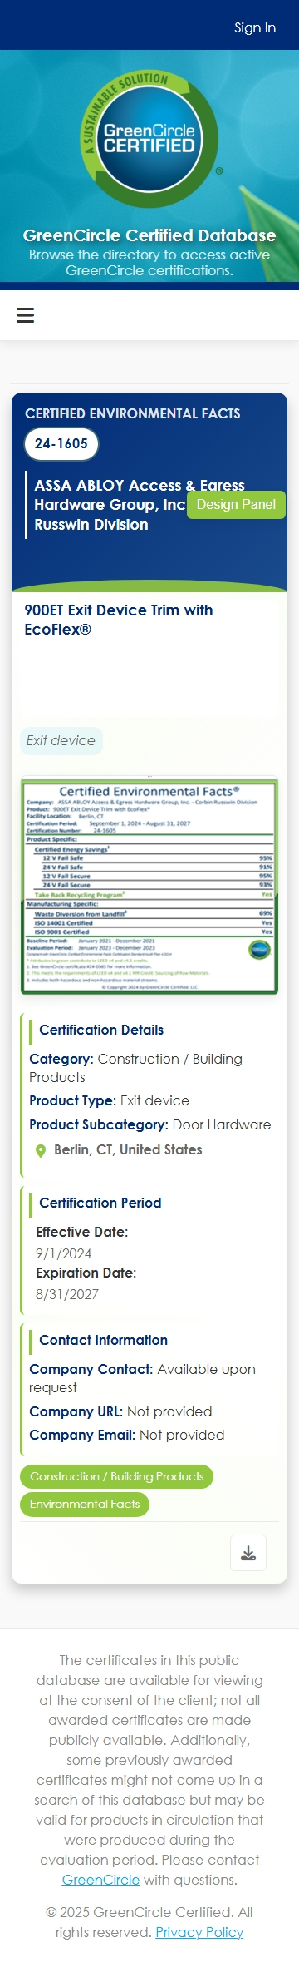
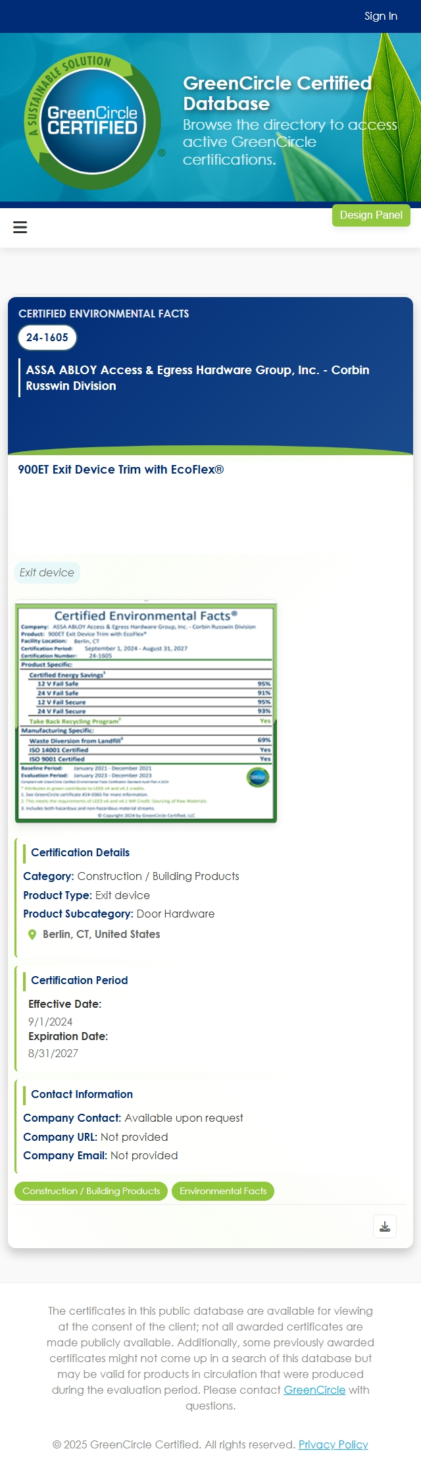
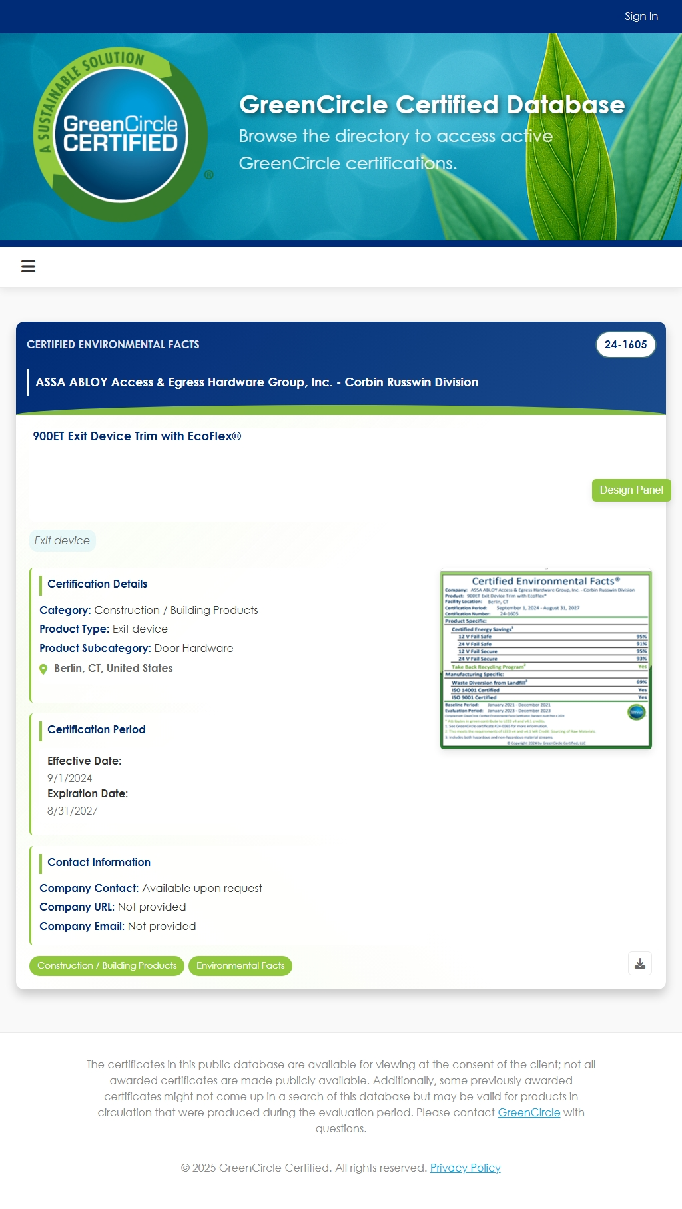
Wireframe Notes – 1.1 – Single Certificate View (Mobile/Tablet Views)
Notes:
View Certificate: Could we have company name and product name at the top - should be designed to be visually appealing and more prominent then the rest.
Either way don't want it to say View Certificate
These are not editable in this view I would not make the fields look like they are text field boxes for editing should be visually appealing
Certificate #
format: add X: format should be: XX-XXXX
If someone tries to manually enter and number exists should have a popup box to confirm if still use or change
Switch Product Name and Company order and put all Product details in same column
Product Type Subcategory: Most will not have subcategory - will it be hidden or just be blank?
Placeholder Image: Make this thumbnail image of the actual certification. Include a preview option to view cert full screen in webpage. Also have download button to download cert (you have just make sure it's closer to the image of cert)
This is not used often but when it is it should appear -- they are also separate - it will be either email, url, or both
would move this to right or bottom so it does not impact other fields
Change external tags to: Tags:
Assume you are considering how we format to pass info in the way Amazon needs (via backend)

Slide 33
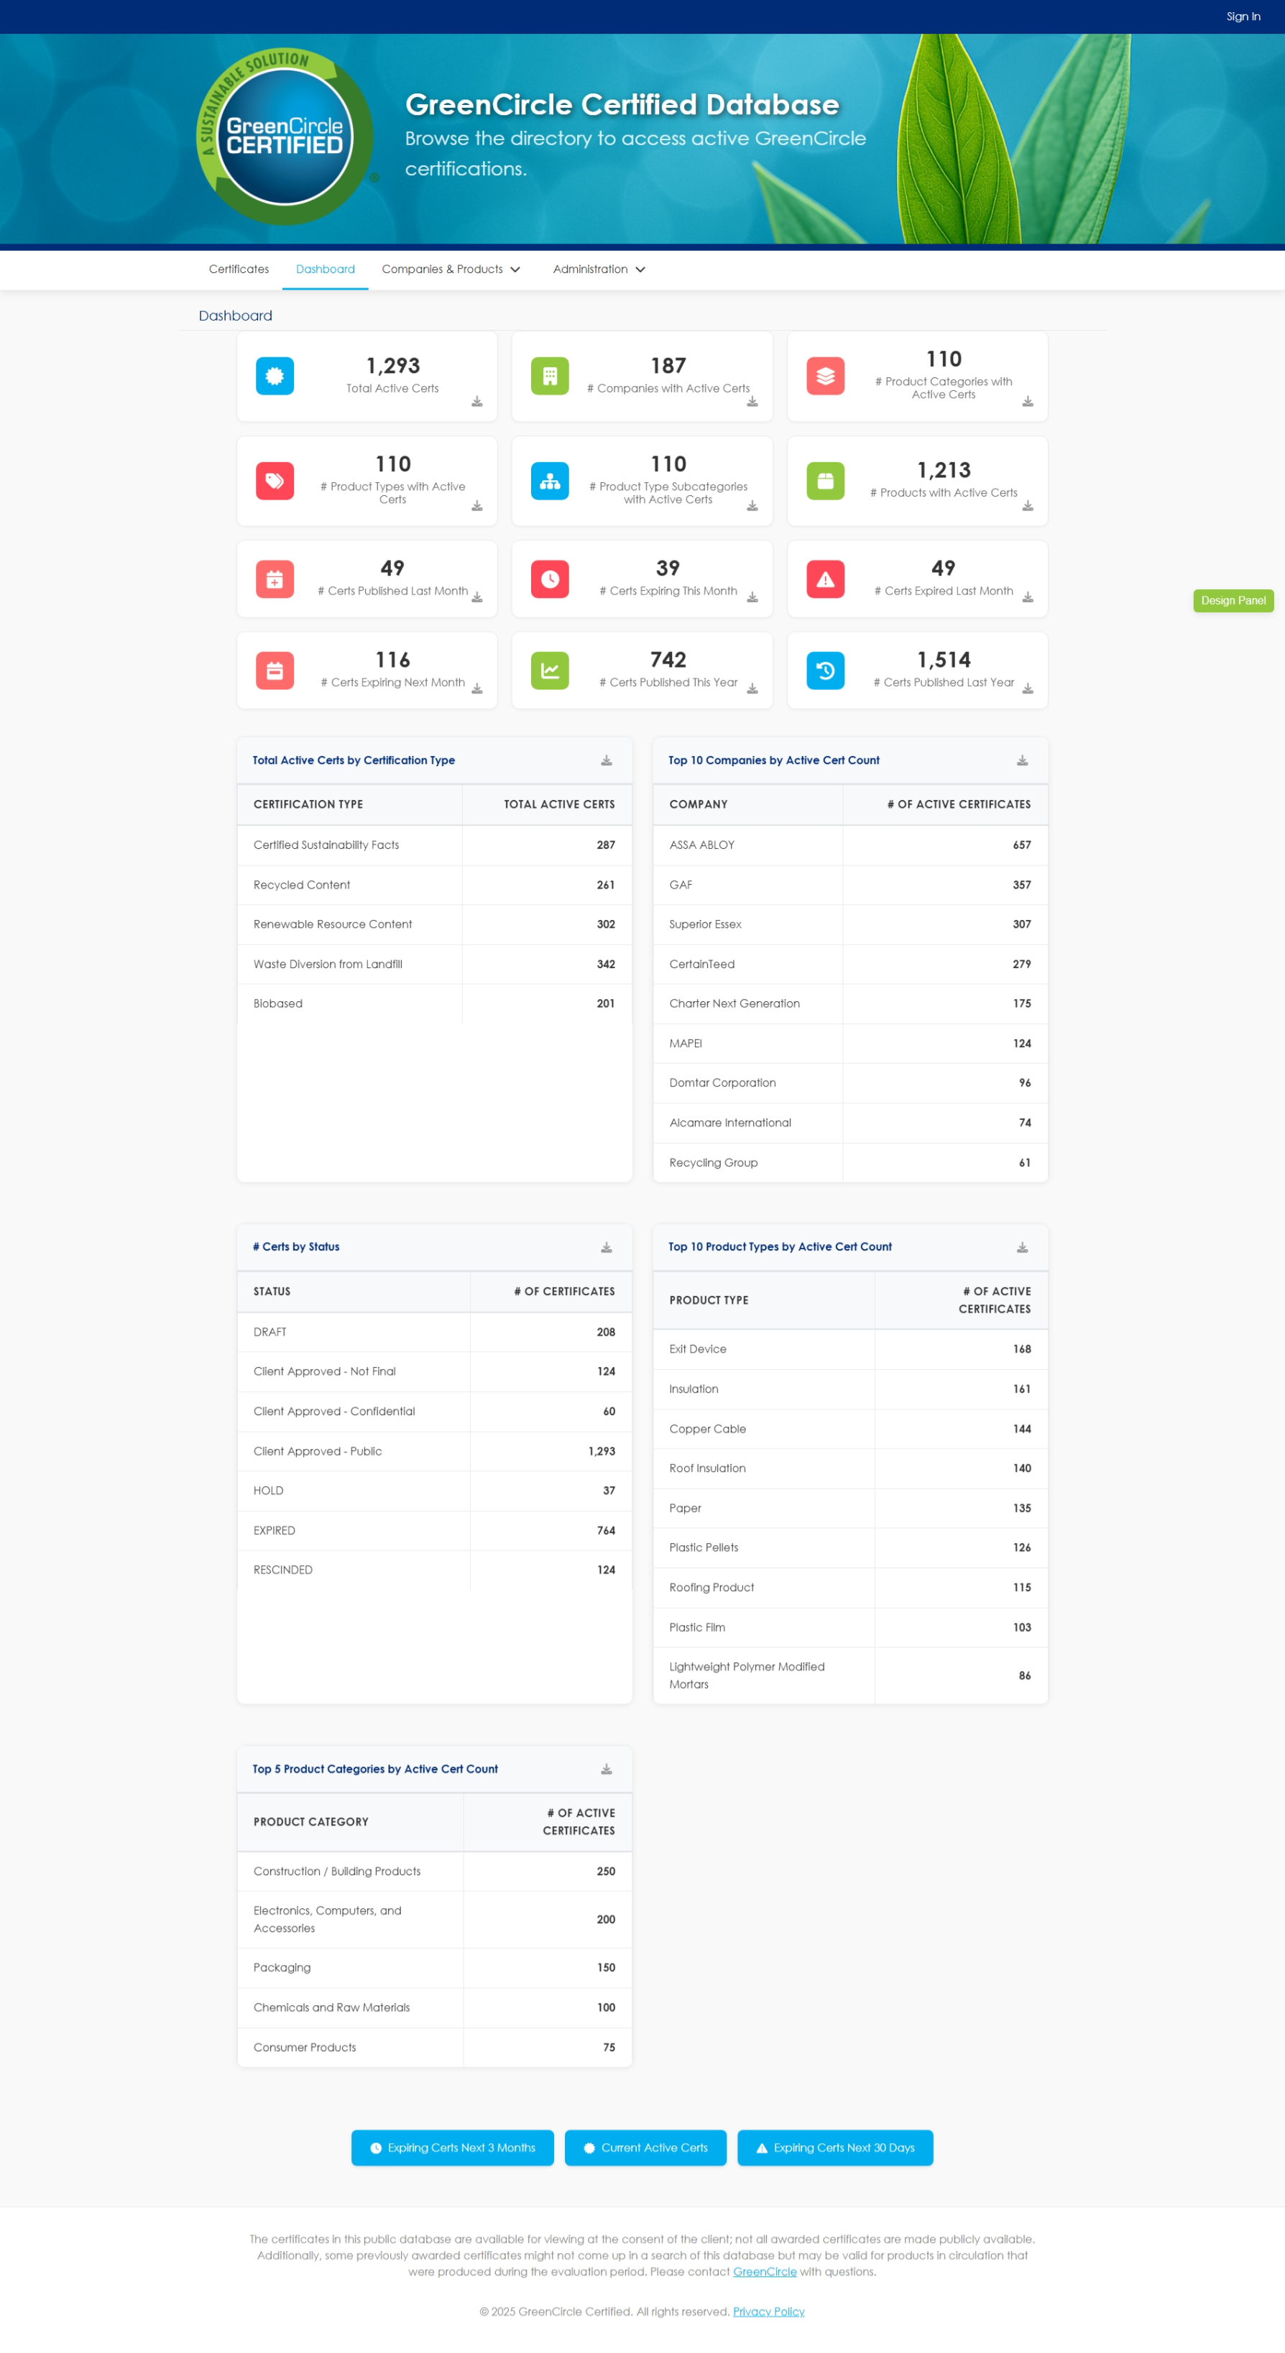
Wireframe Notes – 2.0 – Home (Dashboard)
Notes:
This is the dashboard reporting page for logged in GCC users (Analyst and Admins).
Containers represent the required metrics.
Ability to view designated metrics.
Ability to export Prebuilt Lists to Excel.
Ability to export the selected metric to Excel.
Other
Nice to have, not part of scope, would be to have the dashboard available for external users with there specific data. (out of scope)
Notes:
Home: Unless you can make the data dynamic based on a user's data permissions -- then this will only be accessible to GCC Analyst/Admin roles - therefore, external login users would not see this nav item or this page
Prebuilt lists: Export to Excel buttons: Put at bottom of page after metrics
Missing: Top 5 Product Categories by Active Cert Count
Can Admin create new widgets? Not for this phase.

Slide 34
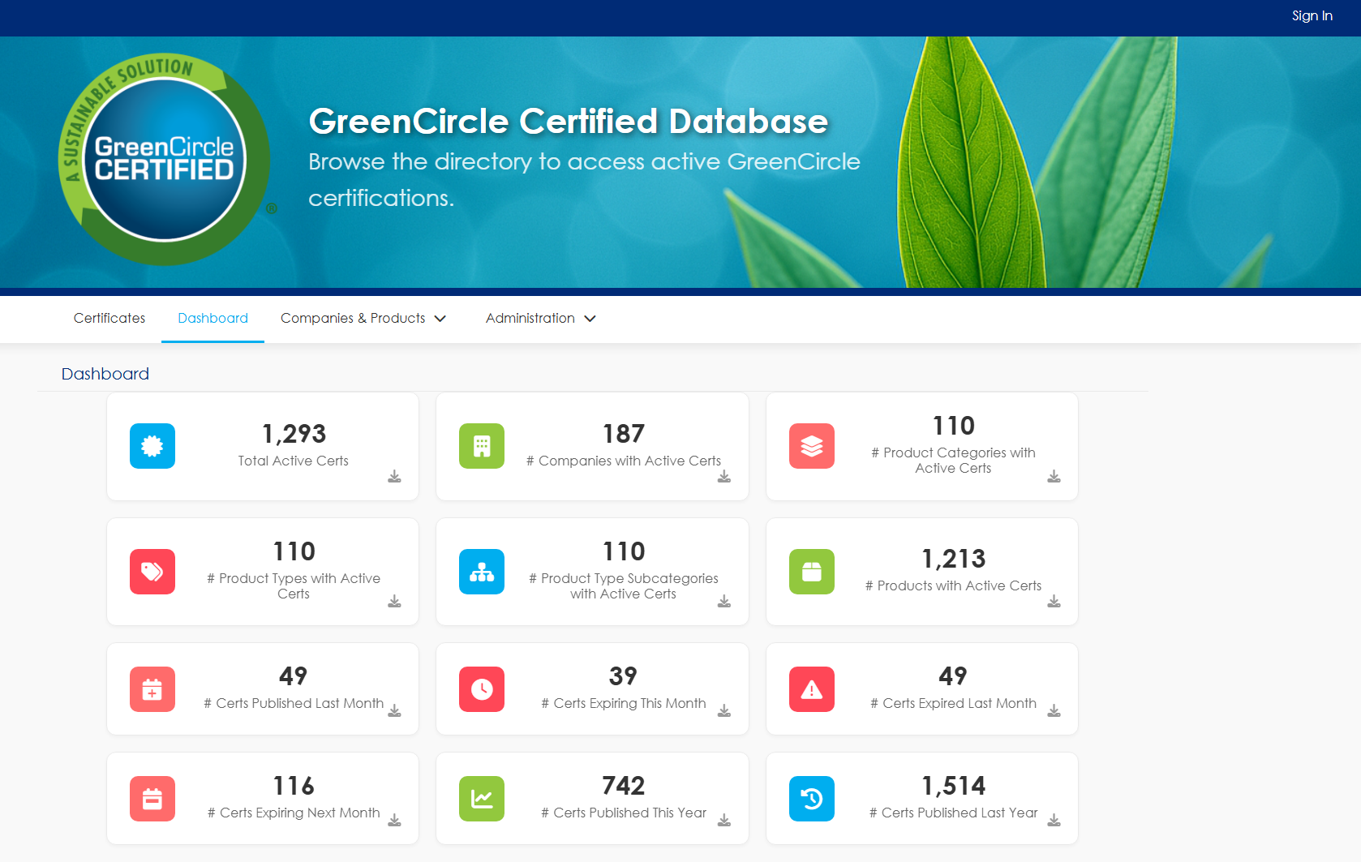
Wireframe Notes – 2.0 – Home (Dashboard)
Notes:
Home: Unless you can make the data dynamic based on a user's data permissions -- then this will only be accessible to GCC Analyst/Admin roles - therefore, external login users would not see this nav item or this page
Prebuilt lists: Export to Excel buttons: Put at bottom of page after metrics
Missing: Top 5 Product Categories by Active Cert Count
Can Admin create new widgets? Not for this phase.

Slide 35
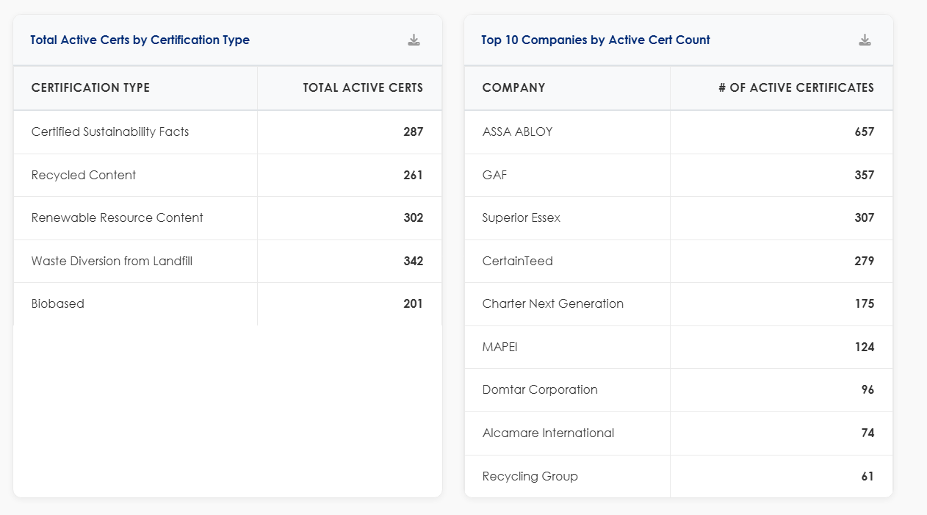
Wireframe Notes – 2.0 – Home (Dashboard)
Notes:
Home: Unless you can make the data dynamic based on a user's data permissions -- then this will only be accessible to GCC Analyst/Admin roles - therefore, external login users would not see this nav item or this page
Prebuilt lists: Export to Excel buttons: Put at bottom of page after metrics
Missing: Top 5 Product Categories by Active Cert Count
Can Admin create new widgets? Not for this phase.

Slide 36
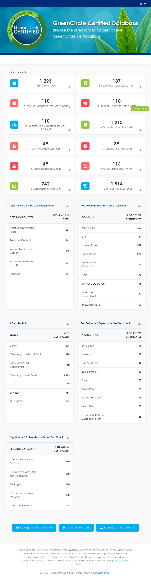
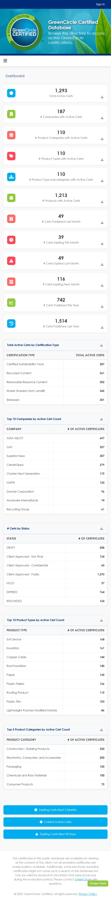
Wireframe Notes – 2.0 – Dashboard (Mobile/Tablet)
Notes:
Home: Unless you can make the data dynamic based on a user's data permissions -- then this will only be accessible to GCC Analyst/Admin roles - therefore, external login users would not see this nav item or this page
Prebuilt lists: Export to Excel buttons: Put at bottom of page after metrics
Missing: Top 5 Product Categories by Active Cert Count
Can Admin create new widgets? Not for this phase.

Slide 37
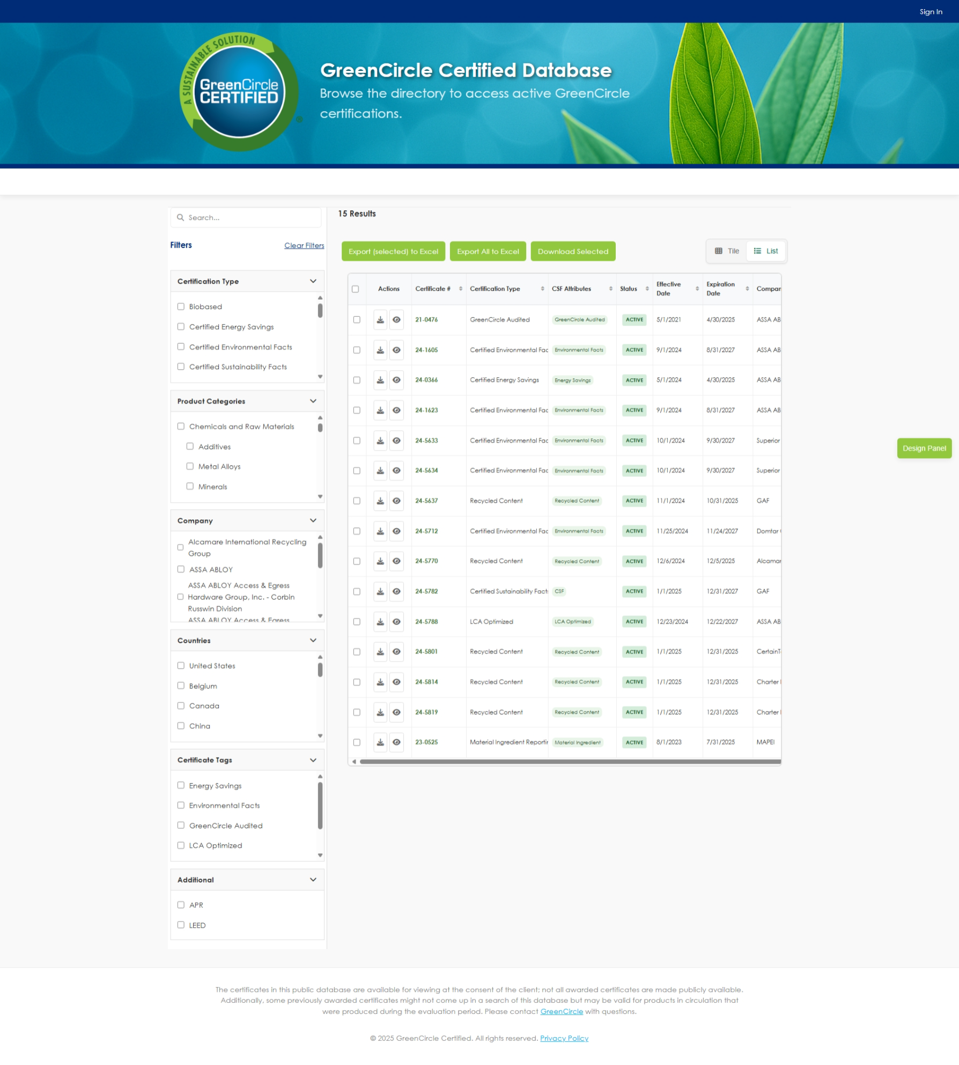
Wireframe Notes – 3.0 – Certificate List (External)
Notes:
Wireframe updated for infinite scrolling instead of pagination.
Add Certificates will only be available for Analyst and Admin users.
Edit/Delete Certificate will only be available for Analyst and Admin users.
Ability to toggle between List and Tile views.
The Tile view will display the same as 1.0 Certificate view.
List Sort by will allows users to sort on any column.
All data fields to be displayed based on user’s permissions: Certificate #, Certification Type, CSF Attributes, Status, Effective Date, Expiration Date, Company, Company Contact Email/URL, Product Name, Product Category, Product Type, Product Type Subcategory, Location, Country, External Tag, Internal Tag, ASIN, UPC, GTIN, EAN, Certificate Upload, Record Created Date, Record Last Updated Date, Preview
2 types of External Users
  Customers (accounted for here)
  Partners (where they will have access across companies for products that are part of their program only – for example Amazon CPF clients/certs) (Need Clarification)
Defaults to List View
Notes:
Remove Tags from Clear Filters/Tags
Paging; allow minimum of 50 per page
Remove Quick tags: global change.
Add Certificates This would only appear for GCC Analyst and Admin - how will this be managed
This will be managed by using page level security. Only GCC analyst and Admin will be able to see or use this functionality.
TODO: Add screen to show this functionality.
Edit Selected Certificate: How does this work when you can multi-select. Either you need to add a row with icons to edit or upon clicking on a single record it opens edit screen but only for internal users
Download Selected Is this to download certifications of items selected? If so make button copy more clear. Also if none are selected and button is clicked will error popup display?
Export Selected to Excel and Export all to Excel: I think you only need 1 button. If you have no filters it will download all. If you have filters selected it will only download your results. This is how current DB works
Can we have a cert preview column (could be little expand / eye icon) - which would display cert image in webpage view. They will also have ability to download but this is just if they want to see it

Slide 38
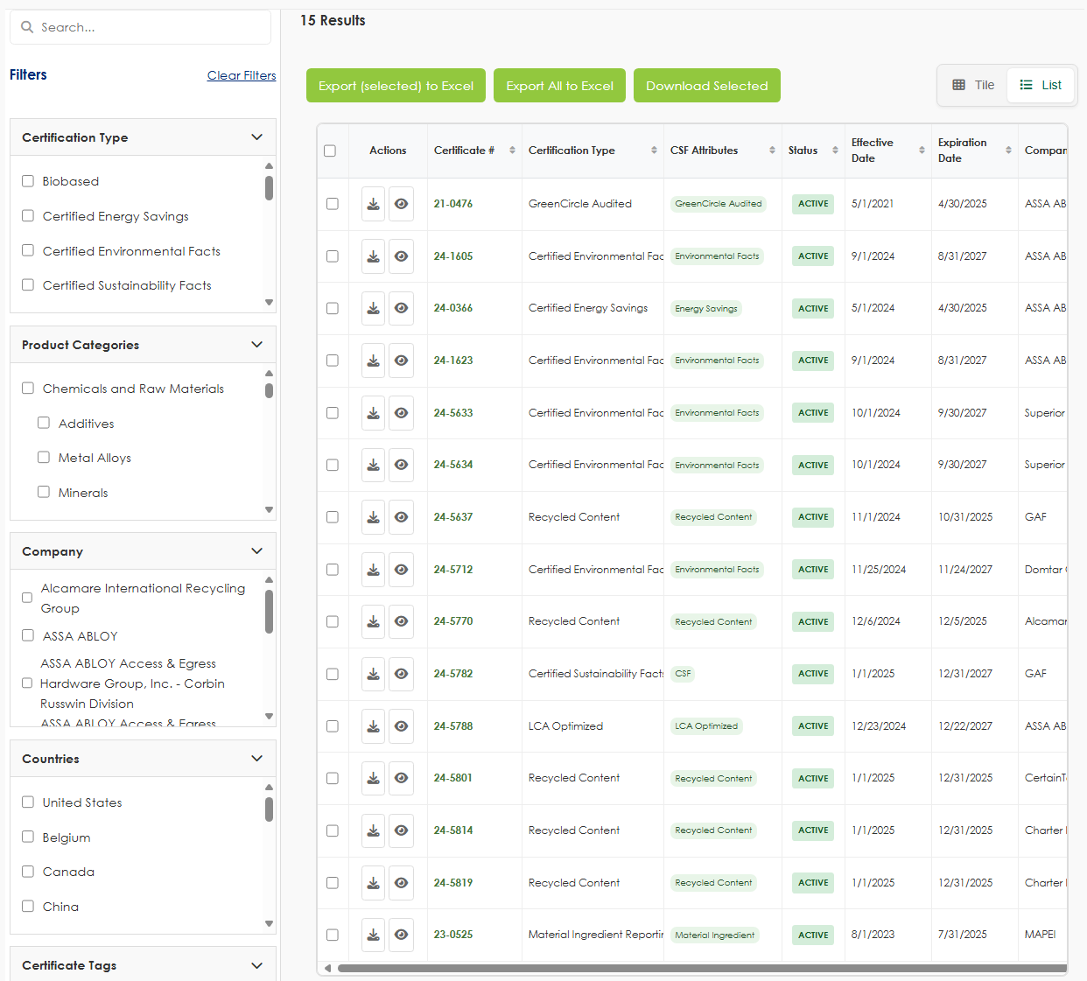
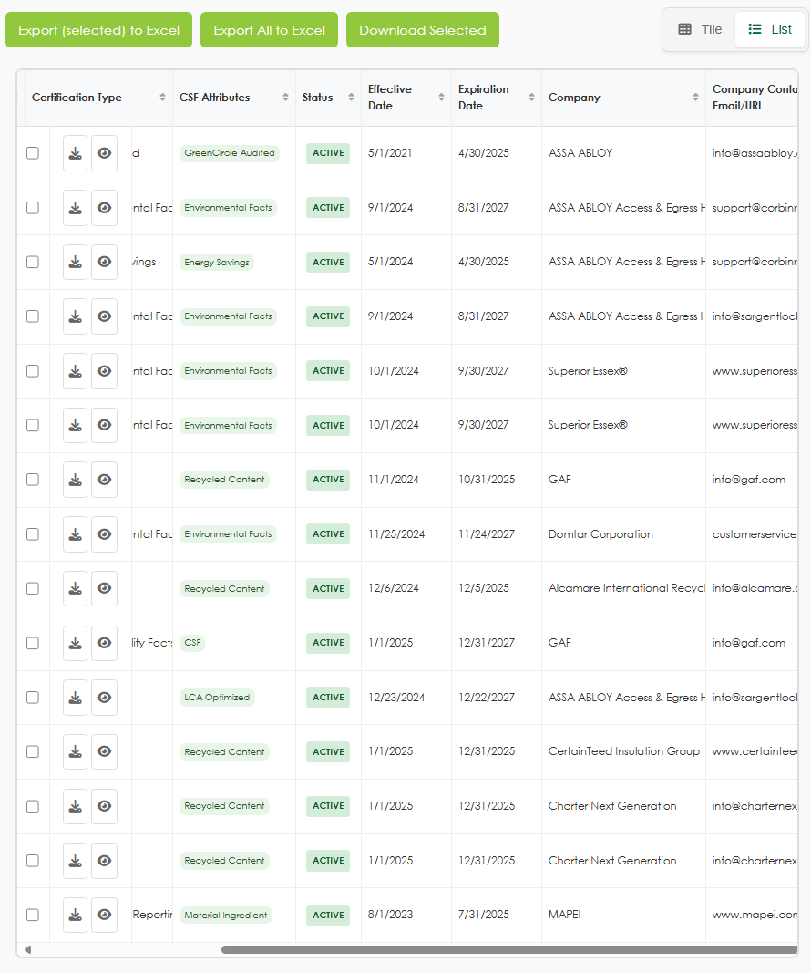
Wireframe Notes – 3.0 – Certificate List (External)
Notes:
Remove Tags from Clear Filters/Tags
Paging; allow minimum of 50 per page
Remove Quick tags: global change.
Add Certificates This would only appear for GCC Analyst and Admin - how will this be managed
This will be managed by using page level security. Only GCC analyst and Admin will be able to see or use this functionality.
TODO: Add screen to show this functionality.
Edit Selected Certificate: How does this work when you can multi-select. Either you need to add a row with icons to edit or upon clicking on a single record it opens edit screen but only for internal users
Download Selected Is this to download certifications of items selected? If so make button copy more clear. Also if none are selected and button is clicked will error popup display?
Export Selected to Excel and Export all to Excel: I think you only need 1 button. If you have no filters it will download all. If you have filters selected it will only download your results. This is how current DB works
Can we have a cert preview column (could be little expand / eye icon) - which would display cert image in webpage view. They will also have ability to download but this is just if they want to see it

Slide 39
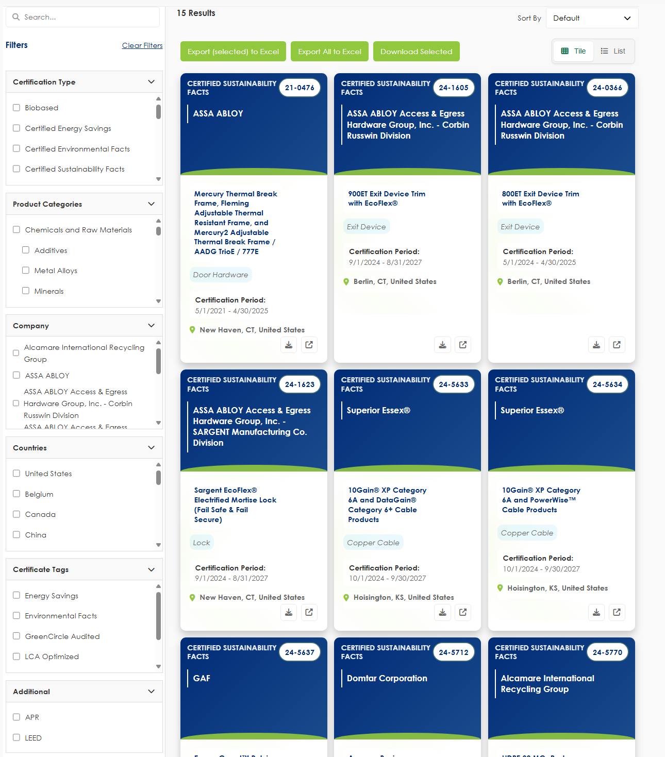
Wireframe Notes – 3.0 – Certificate List (External)
Notes:
Remove Tags from Clear Filters/Tags
Paging; allow minimum of 50 per page
Remove Quick tags: global change.
Add Certificates This would only appear for GCC Analyst and Admin - how will this be managed
This will be managed by using page level security. Only GCC analyst and Admin will be able to see or use this functionality.
TODO: Add screen to show this functionality.
Edit Selected Certificate: How does this work when you can multi-select. Either you need to add a row with icons to edit or upon clicking on a single record it opens edit screen but only for internal users
Download Selected Is this to download certifications of items selected? If so make button copy more clear. Also if none are selected and button is clicked will error popup display?
Export Selected to Excel and Export all to Excel: I think you only need 1 button. If you have no filters it will download all. If you have filters selected it will only download your results. This is how current DB works
Can we have a cert preview column (could be little expand / eye icon) - which would display cert image in webpage view. They will also have ability to download but this is just if they want to see it

Slide 40
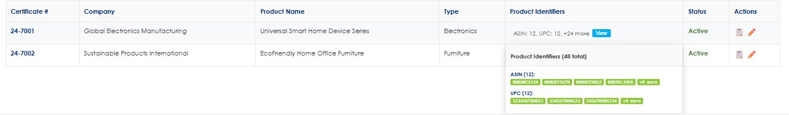
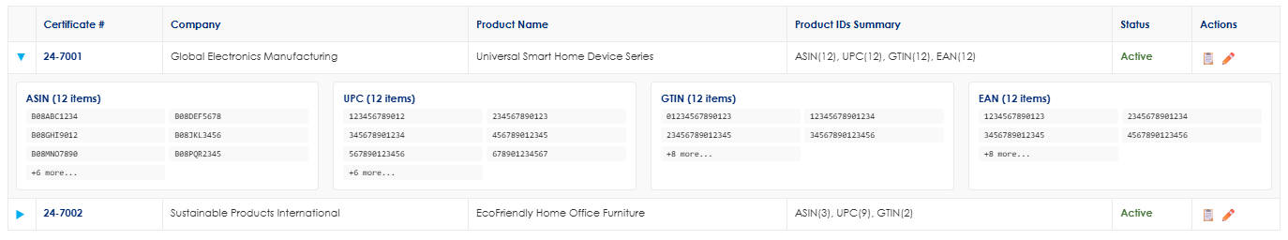
Wireframe Notes – 3.0 – Certificates List (External)(Samples)
Handling a large amount of ASINS Options
  Pending Decision: Discuss how would you handle where there are thousands of ASINs under a certificate.
    May need to give Products page access to external users because listing here would not be realistic. In which case there would not be a column for this, UPC, etc.
Notes:
We need to make sure only GCC users have edit access to a certificate record

Slide 41
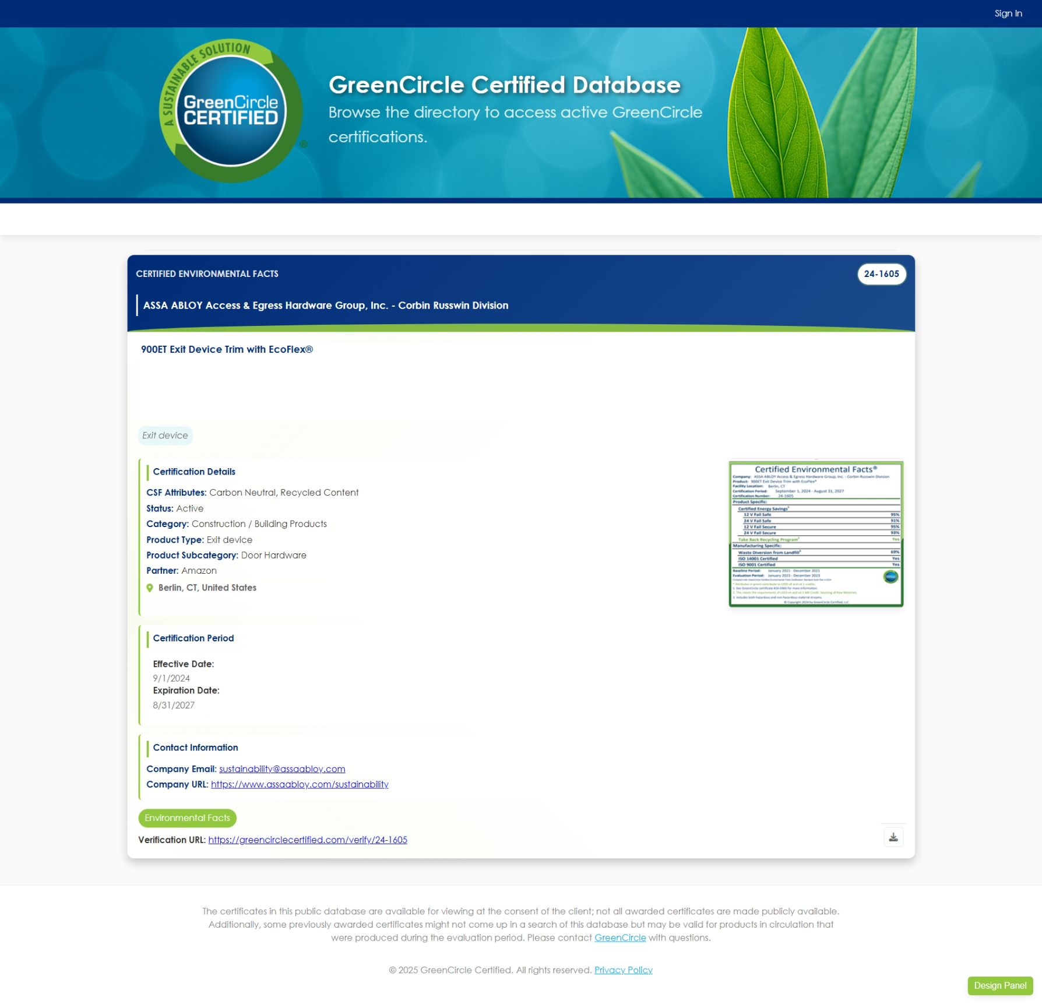
Wireframe Notes – 3.1 – External Single Certificate View
All data fields to be displayed based on user’s permissions: Certificate #, Certification Type, CSF Attributes, Status, Effective Date, Expiration Date, Company, Company Contact Email/URL, Product Name, Product Category, Product Type, Product Type Subcategory, Location, Country, External Tag, Internal Tag, ASIN, UPC, GTIN, EAN, Certificate Upload, Record Created Date, Record Last Updated Date, Preview.
Verification URL: displayed at bottom of page to enable
Certificate View will load in a new tab.
CSF Attribute will only show when it is selected for a certification. (The field will not be required on the certificate create page)
Record Information will only be available for Analyst and Admin
Notes:
Home: They wouldnt see this unless dashboard data reflects their data access.
Not just clients - partners will also be external users and will see certs associated with their program
Add Certificat Button: Remove They could not add Cert remove
Apply applicable comments from page 22

Slide 42
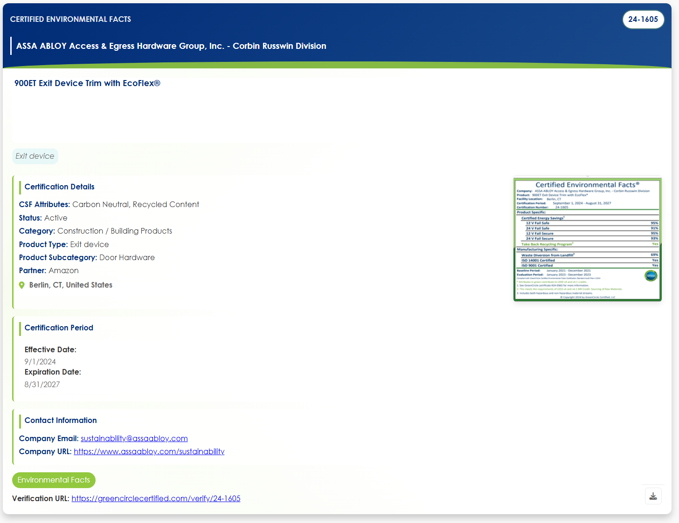
Wireframe Notes – 3.1 – External Single Certificate View
Notes:
Home: They wouldnt see this unless dashboard data reflects their data access.
Not just clients - partners will also be external users and will see certs associated with their program
Add Certificat Button: Remove They could not add Cert remove
Apply applicable comments from page 22

Slide 43
Wireframe Notes – 3.1 – External Single Certificate View
This is the List View for Logged In Clients.
Ability to Sort on all columns.
Ability to Filter by designated Search Categories.
Ability to scroll horizontally and vertically to see additional data fields.
Ability to multiselect for Download.
Will Clients fall under the ‘Company’ data field or is there another way to associate them to a Product/Certificate?
  When we grant permissions to clients it would be through Company - and there could be multiple companies associated with 1 client (ASSA ABLOY for example). However, on the partner side they would not be by Company but by new partner field.
Notes:
When we grant permissions to clients it would be through Company - and there could be multiple companies associated with 1 client (ASSA ABLOY for example)
However, on the partner side they would not be by Company but by tag or new field

Slide 44
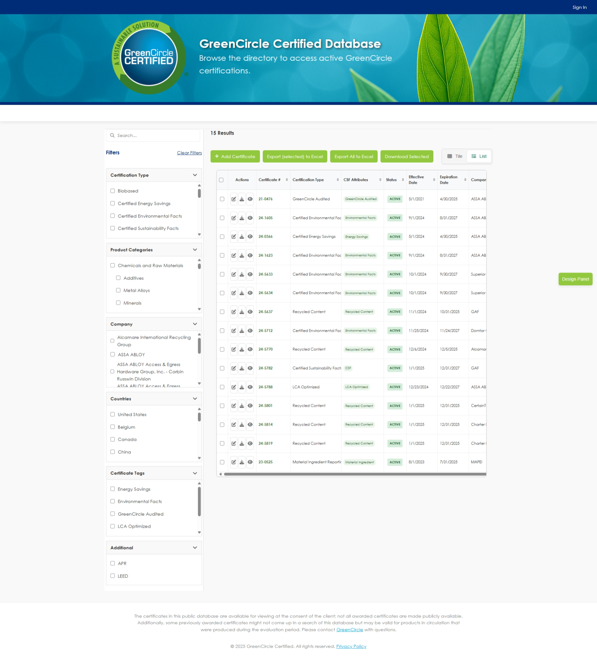
Wireframe Notes – 3.2 – Certificate List (GCC Only)
Notes:
Wireframe updated for infinite scrolling instead of pagination.
Add Certificates will only be available for Analyst and Admin users.
Edit/Delete Certificate will only be available for Analyst and Admin users.
Ability to toggle between List and Tile views.
The Tile view will display the same as 1.0 Certificate view.
List Sort by will allows users to sort on any column.
All data fields to be displayed based on user’s permissions: Certificate #, Certification Type, CSF Attributes, Status, Effective Date, Expiration Date, Company, Company Contact Email/URL, Product Name, Product Category, Product Type, Product Type Subcategory, Location, Country, External Tag, Internal Tag, ASIN, UPC, GTIN, EAN, Certificate Upload, Record Created Date, Record Last Updated Date, Preview
Notes:
Remove Tags from Clear Filters/Tags
Paging; allow minimum of 50 per page
Remove Quick tags: global change.
Add Certificates This would only appear for GCC Analyst and Admin - how will this be managed
This will be managed by using page level security. Only GCC analyst and Admin will be able to see or use this functionality.
TODO: Add screen to show this functionality.
Edit Selected Certificate: How does this work when you can multi-select. Either you need to add a row with icons to edit or upon clicking on a single record it opens edit screen but only for internal users
Download Selected Is this to download certifications of items selected? If so make button copy more clear. Also if none are selected and button is clicked will error popup display?
Export Selected to Excel and Export all to Excel: I think you only need 1 button. If you have no filters it will download all. If you have filters selected it will only download your results. This is how current DB works
Can we have a cert preview column (could be little expand / eye icon) - which would display cert image in webpage view. They will also have ability to download but this is just if they want to see it

Slide 45
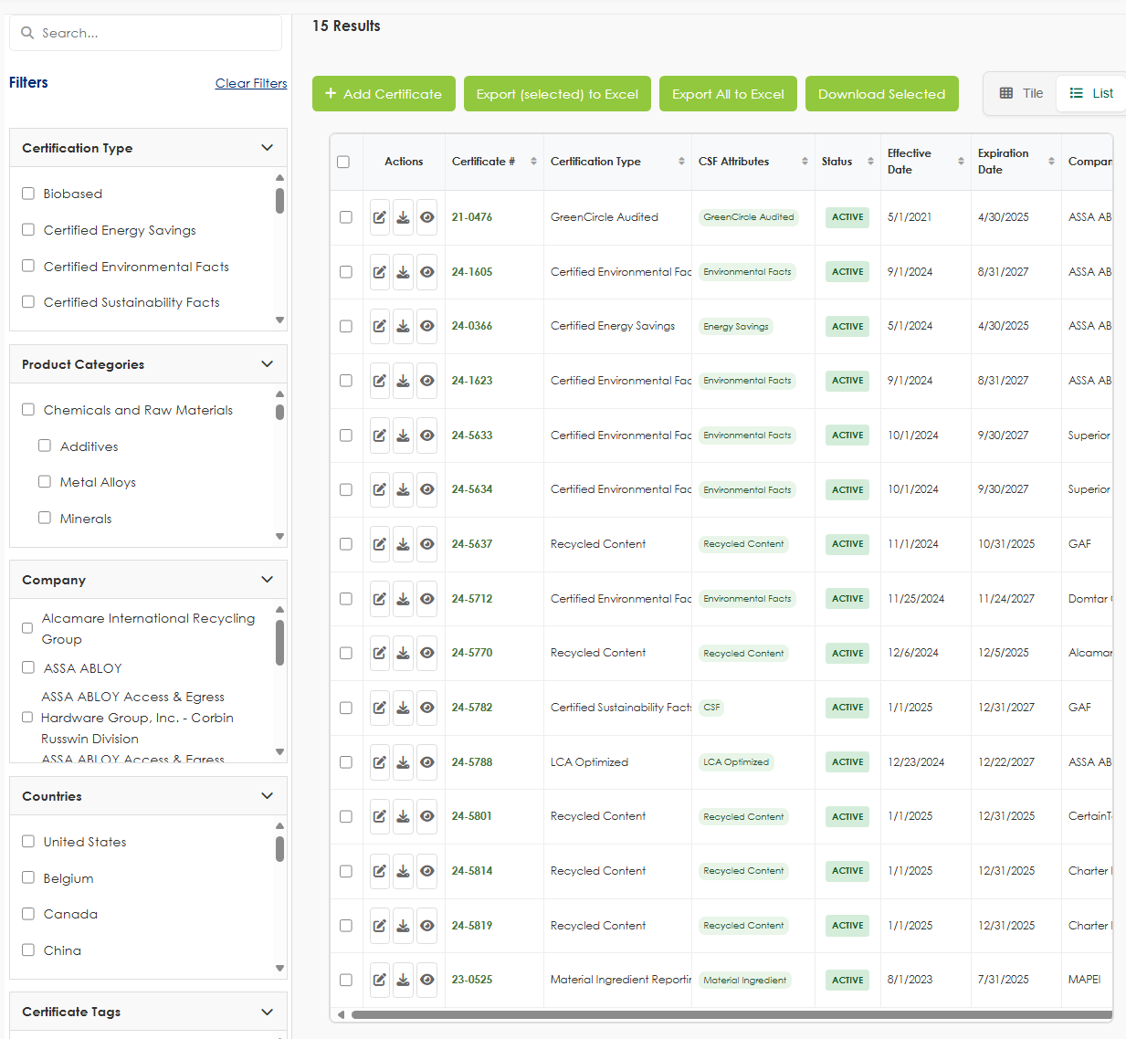
Wireframe Notes – 3.2 – Certificate List (GCC Only)
Notes:
Remove Tags from Clear Filters/Tags
Paging; allow minimum of 50 per page
Remove Quick tags: global change.
Add Certificates This would only appear for GCC Analyst and Admin - how will this be managed
This will be managed by using page level security. Only GCC analyst and Admin will be able to see or use this functionality.
TODO: Add screen to show this functionality.
Edit Selected Certificate: How does this work when you can multi-select. Either you need to add a row with icons to edit or upon clicking on a single record it opens edit screen but only for internal users
Download Selected Is this to download certifications of items selected? If so make button copy more clear. Also if none are selected and button is clicked will error popup display?
Export Selected to Excel and Export all to Excel: I think you only need 1 button. If you have no filters it will download all. If you have filters selected it will only download your results. This is how current DB works
Can we have a cert preview column (could be little expand / eye icon) - which would display cert image in webpage view. They will also have ability to download but this is just if they want to see it

Slide 46
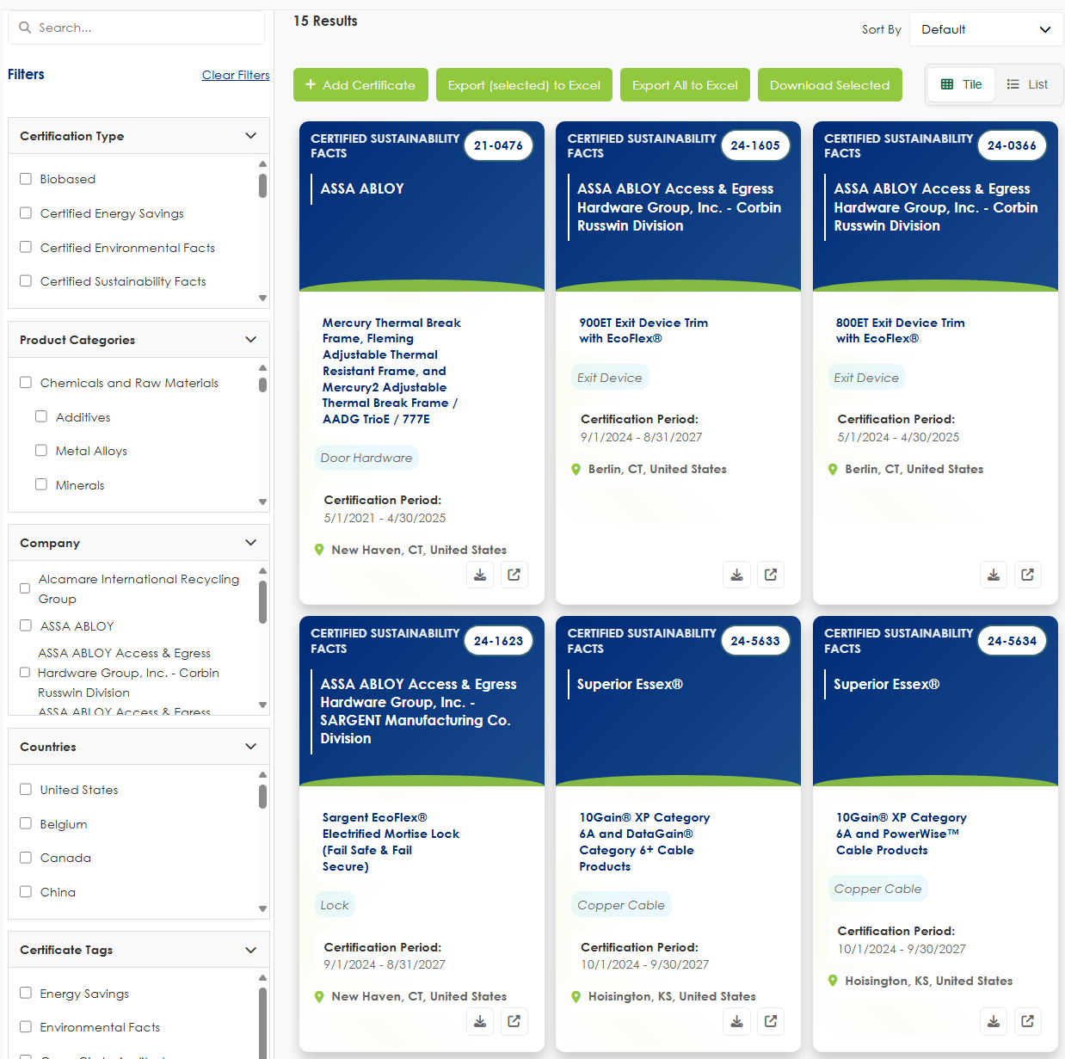
Wireframe Notes – 3.2 – Certificate List (GCC Only)
Notes:
Remove Tags from Clear Filters/Tags
Paging; allow minimum of 50 per page
Remove Quick tags: global change.
Add Certificates This would only appear for GCC Analyst and Admin - how will this be managed
This will be managed by using page level security. Only GCC analyst and Admin will be able to see or use this functionality.
TODO: Add screen to show this functionality.
Edit Selected Certificate: How does this work when you can multi-select. Either you need to add a row with icons to edit or upon clicking on a single record it opens edit screen but only for internal users
Download Selected Is this to download certifications of items selected? If so make button copy more clear. Also if none are selected and button is clicked will error popup display?
Export Selected to Excel and Export all to Excel: I think you only need 1 button. If you have no filters it will download all. If you have filters selected it will only download your results. This is how current DB works
Can we have a cert preview column (could be little expand / eye icon) - which would display cert image in webpage view. They will also have ability to download but this is just if they want to see it

Slide 47
Wireframe Notes – 3.2 – Certificate List (GCC Only)
This is the List View for Logged In Users.
Clicking anywhere on the row of a certificate will take the user to the Certificate List that shows details about the selected Certificate.
Ability to Sort on all columns.
Ability to Filter by designated Search Categories.
Ability to scroll horizontally and vertically to see additional data fields.
Ability to multiselect for Certificate Download.
Ability to Add a Certificate.
Ability to Edit/Delete a selected Certificate.
Note: Edit/Delete will be one at a time, no multiselect.
Excel download - based on filters can export full or filtered list
*Wishlist: The ability to load the table as a user scrolls Lazy loading, rather than have the page control.
Notes:
We need to make sure only GCC users have edit access to a certificate record
All data fields to be displayed based on user’s permissions: Certificate #, Certification Type, CSF Attributes, Status, Effective Date, Expiration Date, Company, Company Contact Email/URL, Product Name, Product Category, Product Type, Product Type Subcategory, Location, Country, External Tag, Internal Tag, ASIN, UPC, GTIN, EAN, Certificate Upload, Record Created Date, Record Last Updated Date, Preview

Slide 48
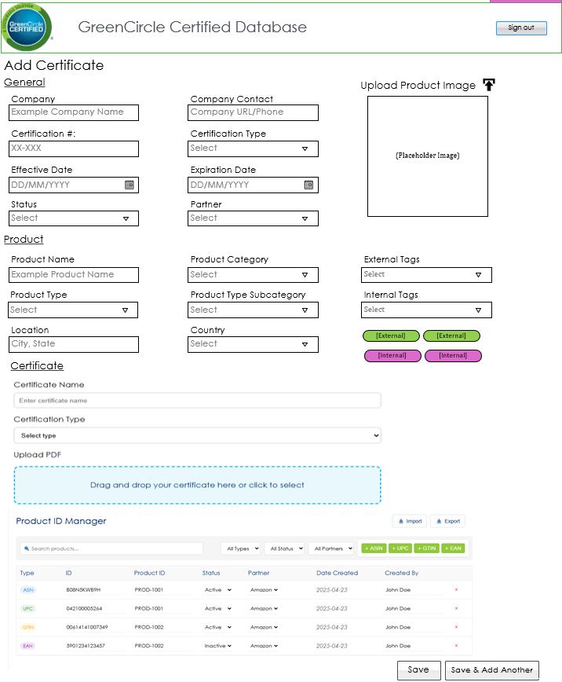
Wireframe Notes – 3.3 – Add Certificate (GCC Only)
Notes:
Admin can add new product categories.
Certification # will be auto generated by the database and created on the save (As discussed prior, unless manually entered, you need instructional copy on the page for this like current db)
New Field: Partner: Amazon/Wayfair - required. (Need to add option of none and multiselect)
New Field: Status Type: to signify if a client doesn’t want to move forward. (This was added based on meeting)
Products will only show if they are associated with the certificate that is being displayed.
Users can select from dropdown existing Products or add a new. Product Category, Type, and Subcategory are not editable on this page and are assigned when adding a new product.
  Update Screenshot, add record information.
  Remove image section
  Change Product ID Manager to Products
  Company Contact should be two different fields. URL and Email (Phone?)
    Info should carry over from the Companies page fields, so it should not be open to edit here. When selecting company it would autopopulate.
Notes:
Anuki explore options for: Clone feature that only carries over certain fields like Cert Type, Company, Dates, Location, Country, Company Contact
And potential Excel mass upload
This would be best on a page not a popup given the amount of fields. Would want it to open in new tab when cert is selected for editing.
How are you allowing mass upload of Amazon ASINs (or UPC, GTIN, EAN)? On these pages we need the listing of ASINs/UPC/etc. that are covered under the cert.
Need to be able to copy and paste ASIN (or other) list or upload in bulk.
We need to add other fields specific to the ASIN associated product. I see that list associated with cert in this view at the botto
You need to show how a GCC Analyst will search/add new Company and Product Names
You need to show how available options show for company or product names -- then if there is not one how to add a new (like current DB)
Also, Product selection is editable AFTER company is selected so it will show the associated products from that company already available
You need to show how you add a New Product and tie that product to the right project type -- within this interface/popup not just in the Products page (see current DB)
Product Name is not a required field.
Certificate #: Not accounting for notification that if left blank will auto assign. Unless you are planning some other way to handle this? But this is key functionality for cert numbering.
Company – Move to General Section
Company Contact: These are either URL or an email address (not phone number). Move to General Section
Location and Country: Put this under General because it could be product or facility level cert
Should list Created On and Last Modified (these fields are system generated and not editable)
and what User Last Modiified
Missing a bunch of fields like CSF Attributes, ASIN, UPC, GTIN, EAN
DISCUSS WITH TEAM: For CSF Attributes: If a specific attribute from the dropdown is selected than that cert would appear in the public search for that cert type. For example if the CSF has Recycled Content, then the CSF would appear when selecting Recycled Content
Tags should be color coded for internal vs external
Need ability to upload certificate file and preview button
Change Submit to Save

Slide 49
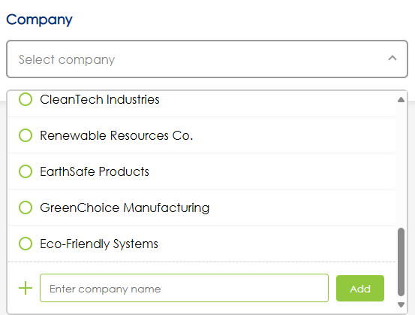
Wireframe Notes – 3.3 – Add Certificate (GCC Only)
Notes:
Example of Multi-select dropdown
Notes:
Anuki explore options for: Clone feature that only carries over certain fields like Cert Type, Company, Dates, Location, Country, Company Contact
And potential Excel mass upload
This would be best on a page not a popup given the amount of fields. Would want it to open in new tab when cert is selected for editing.
How are you allowing mass upload of Amazon ASINs (or UPC, GTIN, EAN)? On these pages we need the listing of ASINs/UPC/etc. that are covered under the cert.
Need to be able to copy and paste ASIN (or other) list or upload in bulk.
We need to add other fields specific to the ASIN associated product. I see that list associated with cert in this view at the botto
You need to show how a GCC Analyst will search/add new Company and Product Names
You need to show how available options show for company or product names -- then if there is not one how to add a new (like current DB)
Also, Product selection is editable AFTER company is selected so it will show the associated products from that company already available
You need to show how you add a New Product and tie that product to the right project type -- within this interface/popup not just in the Products page (see current DB)
Product Name is not a required field.
Certificate #: Not accounting for notification that if left blank will auto assign. Unless you are planning some other way to handle this? But this is key functionality for cert numbering.
Company – Move to General Section
Company Contact: These are either URL or an email address (not phone number). Move to General Section
Location and Country: Put this under General because it could be product or facility level cert
Should list Created On and Last Modified (these fields are system generated and not editable)
and what User Last Modiified
Missing a bunch of fields like CSF Attributes, ASIN, UPC, GTIN, EAN
DISCUSS WITH TEAM: For CSF Attributes: If a specific attribute from the dropdown is selected than that cert would appear in the public search for that cert type. For example if the CSF has Recycled Content, then the CSF would appear when selecting Recycled Content
Tags should be color coded for internal vs external
Need ability to upload certificate file and preview button
Change Submit to Save

Slide 50
Wireframe Notes – 3.3 – Add Certificate (GCC Only)
This is the Add Certificate View.
All Internal View Data:: Certificate #, Certification Type, CSF Attributes, Status, Effective Date, Expiration Date, Company, Company Contact Email/URL, Product Name, Product Category, Product Type, Product Type Subcategory, Location, Country, External Tag, Internal Tag, ASIN, UPC, GTIN, EAN, Certificate Upload, Record Created Date, Last Edited By, Record Last Updated Date, Preview
Ability to Add a Certificate with all Required Data Fields.
**Which data fields are required to Add a Cert?
  Cert Type, Status, Effective Date, Expiration Date, Company, Product Category (required when you have product name), Product Type (required when you have product name), Location, Country, Partner.
  Need to make sure we have N/A option for Product Category, Product Type, Subcategory, Partner.
  Cer # is required – but auto generated by DB if not manually entered.
Which data fields will be generated by the system after adding?
  Just Cert number. It would pull in company contact fields from the Companies page. System also needs to automatically remove expired and inactive certs from public view.
Ability to upload an image to use for the Product.
**Should we incorporate Product Image?
Notes:
This is in doc provided --- only changes are:
Product Name - not required
Product Category - required if there is a Product Name
Certificated Upload - not required

Slide 51
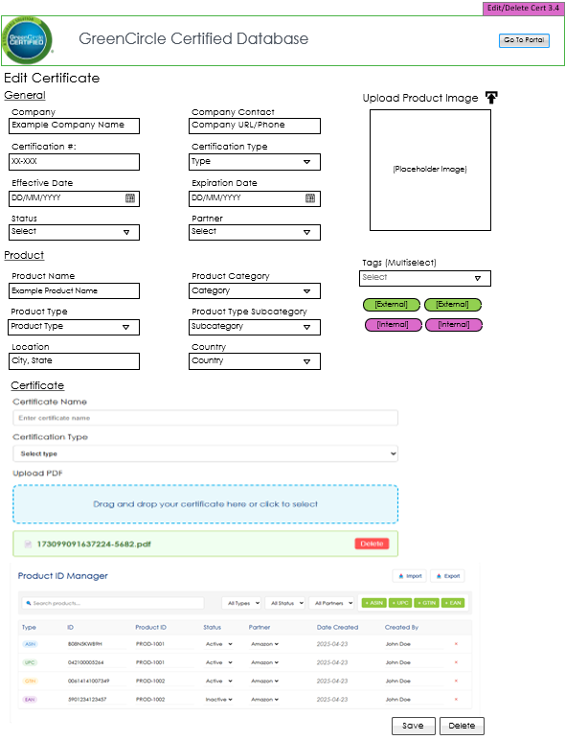
Wireframe Notes – 3.4 – Edit/Delete Certificate (GCC Only)
Updates pending
Admin can add new product categories.
Certification # will be auto generated by the database and created on the save
New Field: Partner: Amazon/Wayfair - required.
New Field: Status Type: to signify if a client doesn’t want to move forward.
This is the Edit/Delete Certificate View.
All Internal View Data: Certificate #, Certification Type, CSF Attributes, Status, Effective Date, Expiration Date, Company, Company Contact Email/URL, Product Name, Product Category, Product Type, Product Type Subcategory, Location, Country, External Tag, Internal Tag, ASIN, UPC, GTIN, EAN, Certificate Upload, Record Created Date, Last Edited By, Record Last Updated Date, Preview
Company Contact: separate into two URL/Email
Ability to Edit/Delete the selected Certificate information and file.
The Products section should only show products under the Cert# being viewed.
Users can select from dropdown existing Products or add a new. Product Category, Type, and Subcategory are not editable on this page and are assigned when adding a new Product. (see current DB?)
Notes:
Same comments as other page. Need to also be able to remove and replace prior cert PDF
There should be a confirmation box that appears asking if they are sure they want to delete

Slide 52
Wireframe Notes – 5.0 – Companies & Products
Navigation only, not a page.

Slide 53
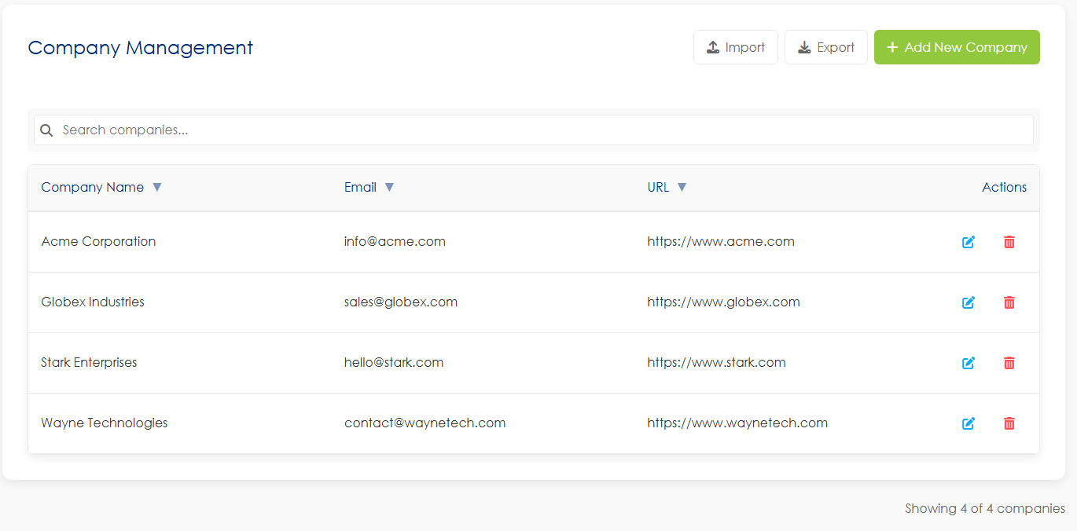
Wireframe Notes – 5.1 – Companies
Required Fields
Company Name - Required dropdown with add capability (as referenced in Cert Upload Fields)
Company Contact Email - Separate field from URL
Company Contact URL - Separate field from Email

Slide 54
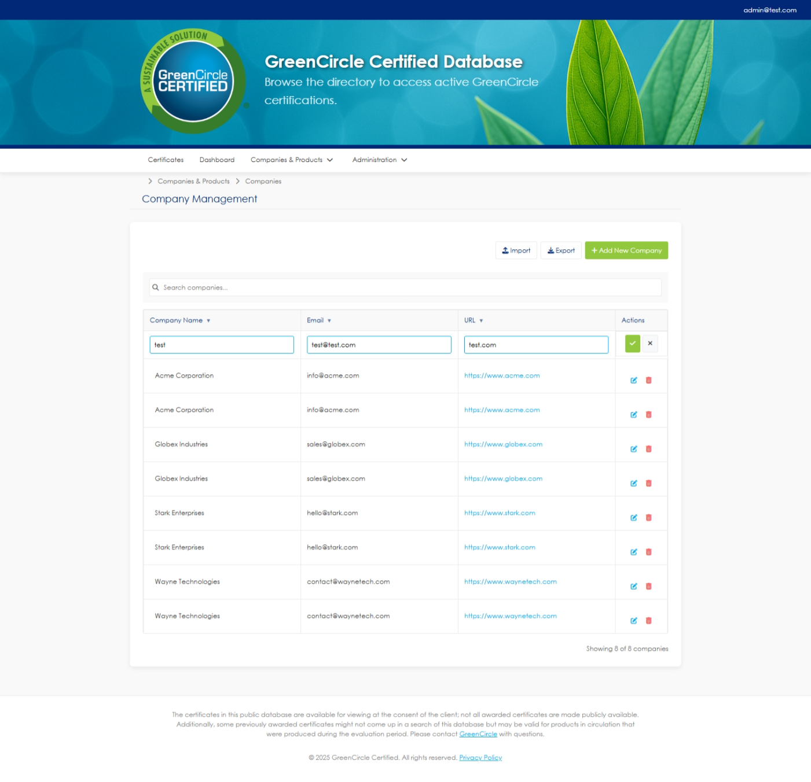
Wireframe Notes – 5.1 – Companies

Slide 55
Wireframe Notes – 5.1 – Companies
Data Integration & Auto-Population
Certificate Auto-Population: Company information from the Company Management screen should auto-populate when creating/editing certificates
Field Mapping: When selecting a company during certificate creation, Email and URL fields auto-populate and are not editable on the certificate form
Contact Information Usage: Only Email and URL are used as contact options on certificates (Phone field eliminated)
Import/Export Behavior
Smart Import Logic: Import compares existing data and only uploads new records
Update Handling: If existing Certificate # is uploaded, only changed fields are updated
Data Integrity: Import will not override current data unless changes are detected
Audit Trail: History table tracks all changes made through imports or manual updates
Key Decisions Made
Phone Field Eliminated: Replaced with URL field for certificate contact information
Two Contact Fields Only: Email and URL are the sole contact options
Auto-Population Confirmed: Company data from management screen carries over to certificates
Import Strategy: Compare-and-update approach prevents data loss
Notes:
Company Management screen:
Includes: Company Name, Company Contact
Separate out Contact Email and Phone into two separate fields
DISCUSS: Does this information populate under the cert if it’s listed here? If we aren’t using this to auto populate that then we don’t need anything, but company name here.
Will import ever override current?
The import will do a compare of the data to only upload new records.
If existing Certficate # is uploaded it will update the fields that have changed.
History table will be updated in the DB of the change.
Does email get used on the Cert? If so rename so more clear…
Does Phone get used on the Cert? If so replace with URL on Cert.
Only email and URL as contact options.

Slide 56
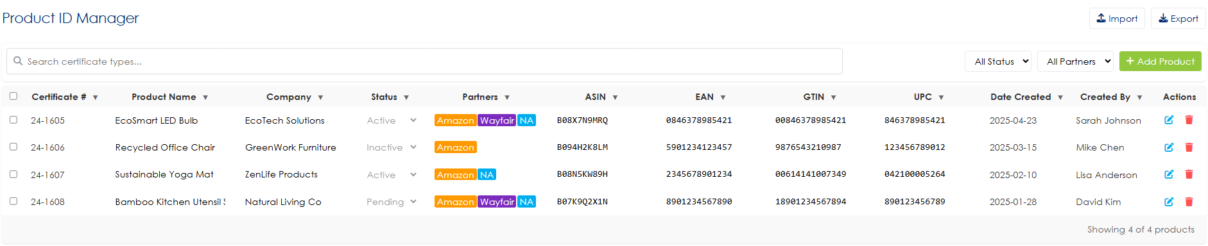
Wireframe Notes – 5.2 – Products
Notes:
Admin users see: All buttons (Import, Export, Add Product), edit/delete actions, bulk operations
Partner/Client users would see: Read-only view with no administrative functions
Product identifier management for multiple types: ASIN, UPC, GTIN, and EAN
Search functionality to quickly find products
Filtering options by type, status, and partners
Status tracking (Active/Inactive) for each product ID
Partner association (currently showing Amazon)
Creation date and creator tracking
Import and export capabilities for bulk management
Adding new identifiers with dedicated buttons for each type
Linking multiple identifier types to the same product ID (as shown with PROD-1001 and PROD-1002)
Table view with deletion options (x button) for each entry
Notes:
I think Partners and Clients should have access to this without the add, edit, delete and import items. They would also see based on their permissions.
This is the wrong section. Not 3.3
Transform Type to individual columns (ASIN, EAN, GTIN, UPC)
Make this the first column then product name, company, status, partner, then numbers.
Review: Would need to allow multiple parnters.
The API would identify what get passed per…..????
What about multi-select for deletion and status change
Isn't this same as page 59? See those comments too, is this the one just for bottom of cert page?
REVIEW: would need to allow multiple partners.!!!!!
THE API would identify what gets paseed per…..???

Slide 57

Wireframe Notes – 5.2 – Products (Add)
Notes:
I think Partners and Clients should have access to this without the add, edit, delete and import items. They would also see based on their permissions.
This is the wrong section. Not 3.3
Transform Type to individual columns (ASIN, EAN, GTIN, UPC)
Make this the first column then product name, company, status, partner, then numbers.
Review: Would need to allow multiple parnters.
The API would identify what get passed per…..????
What about multi-select for deletion and status change
Isn't this same as page 59? See those comments too, is this the one just for bottom of cert page?
REVIEW: would need to allow multiple partners.!!!!!
THE API would identify what gets paseed per…..???

Slide 58

Wireframe Notes – 5.2 – Products (Edit)
Notes:
I think Partners and Clients should have access to this without the add, edit, delete and import items. They would also see based on their permissions.
This is the wrong section. Not 3.3
Transform Type to individual columns (ASIN, EAN, GTIN, UPC)
Make this the first column then product name, company, status, partner, then numbers.
Review: Would need to allow multiple parnters.
The API would identify what get passed per…..????
What about multi-select for deletion and status change
Isn't this same as page 59? See those comments too, is this the one just for bottom of cert page?
REVIEW: would need to allow multiple partners.!!!!!
THE API would identify what gets paseed per…..???

Slide 59
Wireframe Notes – 7.0 – Administration
Admin Section does not have a main landing page.

Slide 60

Wireframe Notes – 7.1 – Role Management
This is the Role Management (Page Level) Admin View.
Ability to Manage which roles have access to which pages of the site.
Ability to cancel changes.
Admin Users have access to all pages by default.
Delete disabled for Admin, Admin Panel checkbox disabled for Admin.
Notes:
Change Submit to Save
Cancel word remove
What do you mean by pages? Trying to understand a use case for this. Sometimes we have same pages but the features on them could be different
The external user needs to be based on selected field filters or field types, which is not represented and needs to be accounted for. It would be unique per USER, not really by role. May be nice to clone these users if we have several from 1 org with same access level

Slide 61

Wireframe Notes – 7.1.1 – CRUD Role
Notes:
Change Submit to Save
Cancel word remove
What do you mean by pages? Trying to understand a use case for this. Sometimes we have same pages but the features on them could be different
The external user needs to be based on selected field filters or field types, which is not represented and needs to be accounted for. It would be unique per USER, not really by role. May be nice to clone these users if we have several from 1 org with same access level

Slide 62

Wireframe Notes – 7.2 – User Management
This is the Users (Roles) Admin View.
Ability to Add a new User.
Ability to Edit a selected current User.
an only Edit one user at a time.
Ability to navigate between admin screens via navigation.
Notes:
Add: Ability to export user list
Is Edit Selected User button needed?
Remove (Roles) from image
What is the select checkbox for? Why couldn't you just click on user and go into edit view
Only thing i can see multi-select helpful for is to delete users
Add Column for Company

Slide 63


Wireframe Notes – 7.2.1 – CRUD User (Add/Edit)
Notes:
Add: Ability to export user list
Is Edit Selected User button needed?
Remove (Roles) from image
What is the select checkbox for? Why couldn't you just click on user and go into edit view
Only thing i can see multi-select helpful for is to delete users
Add Column for Company

Slide 64
Wireframe Notes – 7.2.1 – CRUD User
Method | Description | Security Level | Recommended
TOTP Authenticator | Google Authenticator, Microsoft Authenticator, Authy (via QR code/secret) | High | Default
SMS OTP | One-time code sent via text message | Medium | Optional
Email OTP | One-time code sent to email | Medium | Optional
Backup Codes | Downloadable list of one-time recovery codes | High | Required upon setup
For Admin Role
Enforce TOTP
Disallow SMS-only
Require periodic re-authentication for critical operations

Slide 65
Wireframe Notes – 7.2.1 – CRUD User
Data to Collect and Securely Store:
Field | Use
email | Login and recovery
phone_number (optional) | For SMS OTP
totp_secret (encrypted) | For TOTP verification (base32-encoded)
recovery_codes[] | One-time recovery (hashed or encrypted)
2fa_enabled | Boolean toggle
2fa_method | email, sms, totp
mfa_verified_at | Timestamp of last verification
is_admin | Flag for admin access (to enforce stricter MFA policies)
device_tokens[] (opt.) | For device trust or remembered sessions

Slide 66
Wireframe Notes – 7.3 – Configuration Settings
Navigation only.

Slide 67


Wireframe Notes – 7.3.1 – Google Analytics

Slide 68

Wireframe Notes – 7.4 – API Management

Slide 69
Wireframe Notes – 7.4.1 – Amazon API Integration
Sample JSON to send to Amazon
[
{
"product_name": "EcoSmart LED Bulb",
"product_id_type": “ASIN",
"product_id": "123456789012",
"certification_country": "US",
"certification_agency": "greencircle_energy_savings",
"certification_standard": "",
"certification_value": "",
"certification_end_date": "2025-12-31",
"certification_status": "certified"
},
{
"product_name": "Recycled Office Chair",
"product_id_type": “ASIN",
"product_id": "9876543210987",
"certification_country": "UK",
"certification_agency": "greencircle_recycled_content",
"certification_standard": "",
"certification_value": "",
"certification_end_date": "2024-11-01",
"certification_status": "not certified"
}
]
Notes:
API will send multiple records for certificates with multiple product IDs:
json
[ { "certificate_number": "25-0001",
"product_id_type": "ASIN",
"product_id": "B07EXAMPLE",
// ... other fields },
{ "certificate_number": "25-0001",
"product_id_type": "ASIN",
"product_id": "123456789012",
// ... other fields (duplicate certificate data) }
]

Slide 70
Wireframe Notes – 7.5 – Data Management
Navigation only.

Slide 71

Wireframe Notes – 7.5.1 – Certificate Types
Notes:
Save (not submit)

Slide 72

Wireframe Notes – 7.5.1 – Certificate Types (Add)
This is the Certificate Types Admin View.
Ability to Add or Edit Certificate Types.
The save row in the screenshot is to show the add view of the data grid. It would only be visible when a user clicks the Add New Certificate Type Button.
Notes:
Save (not submit)

Slide 73

Wireframe Notes – 7.5.1 – Certificate Types (Edit)
Notes:
Save (not submit)

Slide 74

Wireframe Notes – 7.5.2 – Product Types (Tree View)
Notes:
Need a way to be able to delete and edit Product Names (in case had issue with prior or Product Name is no longer valid)
Purpose of the Select All?
With so many product types will want to be able to search and sort this list
Product Type Subcategory: Why are these numbered and with multiple?
Ability to sort by alphabetical order for any column
Can just click on to edit since you can't edit multiple at once
Remove item from Add New button
With so many product types will want to be able to search and sort this list

Slide 75

Wireframe Notes – 7.5.2 – Product Types (Tree View)
This is the Product Types Admin View.
Ability to Add Product Categories, Product Types, and Product Type Subcategories.
Ability to Edit/Delete Selected Line Item.
One-to-Many relationship between Product Types, and Product Type Subcategories.
Notes:
Need a way to be able to delete and edit Product Names (in case had issue with prior or Product Name is no longer valid)
Purpose of the Select All?
With so many product types will want to be able to search and sort this list
Product Type Subcategory: Why are these numbered and with multiple?
Ability to sort by alphabetical order for any column
Can just click on to edit since you can't edit multiple at once
Remove item from Add New button
With so many product types will want to be able to search and sort this list

Slide 76

Wireframe Notes – 7.5.2 – Product Types (Tree View – Edit)
Notes:
Need a way to be able to delete and edit Product Names (in case had issue with prior or Product Name is no longer valid)
Purpose of the Select All?
With so many product types will want to be able to search and sort this list
Product Type Subcategory: Why are these numbered and with multiple?
Ability to sort by alphabetical order for any column
Can just click on to edit since you can't edit multiple at once
Remove item from Add New button
With so many product types will want to be able to search and sort this list

Slide 77

Wireframe Notes – 7.5.2 – Product Types (Table View)
Notes:
Need a way to be able to delete and edit Product Names (in case had issue with prior or Product Name is no longer valid)
Purpose of the Select All?
With so many product types will want to be able to search and sort this list
Product Type Subcategory: Why are these numbered and with multiple?
Ability to sort by alphabetical order for any column
Can just click on to edit since you can't edit multiple at once
Remove item from Add New button
With so many product types will want to be able to search and sort this list

Slide 78

Wireframe Notes – 7.5.3 – Certification Field Management
Fields:
Public Users: Certificate #, Certification Type, Effective Date, Expiration Date, Company, Company Contact Email/URL, Product Name, Product Category, Product Type, Product Type Subcategory, Location, Country, External Tag
External/Client Users: All public fields plus CSF Attributes, Status, Internal Tag, ASIN, UPC, GTIN, EAN, Certificate Upload
Analyst/Admin Users: All fields including Record Information (Created Date, Last Updated Date, Last Edited By)
Fields auto-append to bottom of their assigned section for logical grouping

Slide 79

Wireframe Notes – 7.5.3 – Certification Field Management (Add)

Slide 80




Wireframe Notes – 7.5.3 – Certification Field Management
Field Visibility by User Role
Public Users: Certificate #, Certification Type, Effective Date, Expiration Date, Company, Company Contact Email/URL, Product Name, Product Category, Product Type, Product Type Subcategory, Location, Country, External Tag
External/Client Users: All public fields plus CSF Attributes, Status, Internal Tag, ASIN, UPC, GTIN, EAN, Certificate Upload
Analyst/Admin Users: All fields including Record Information (Created Date, Last Updated Date, Last Edited By)
Fields auto-append to bottom of their assigned section for logical grouping

Slide 81
Wireframe Notes – 7.5.3 – Certification Field Management
Section | Field Name | Control Type | Required | Notes
Core Certificate Information | Certificate # | Text | Optional | Auto-generated if left blank
Core Certificate Information | Certification Type | Dropdown | Required | Type of certification issued
Core Certificate Information | CSF Attributes | Multi-Select | Optional | Certification specific framework attributes
Core Certificate Information | Status | Dropdown | Required | Required for public visibility
Core Certificate Information | Effective Date | Date | Required | When the certification becomes effective
Core Certificate Information | Expiration Date | Date | Required | When the certification expires
Company Information | Company | Text | Required | Company receiving certification
Company Information | Company Contact Email | Text | Optional | Company email contact
Company Information | Company Contact URL | Text | Optional | Company website URL
Product Information | Product Name | Text | Required | Name of the certified product
Product Information | Product Category | Dropdown | Required | Main category of the product
Product Information | Product Type | Dropdown | Required | Specific type within category
Product Information | Product Type Subcategory | Dropdown | Required | Subcategory within product type
Product Information | Location | Text | Optional | Manufacturing or certification location
Product Information | Country | Dropdown | Required | Country of origin
Product Identifiers | ASIN | Text | Optional | Amazon Standard Identification Number
Product Identifiers | UPC | Text | Optional | Universal Product Code
Product Identifiers | GTIN | Text | Optional | Global Trade Item Number
Product Identifiers | EAN | Text | Optional | European Article Number
Tagging & Classification | External Tag | Multi-Select | Optional | External classification tags
Tagging & Classification | Internal Tag | Multi-Select | Optional | Internal classification tags
New Required Fields | Partner | Multi-Select | Required | Amazon/Wayfair/None/Other partners
New Required Fields | Status Type | Dropdown | Optional | To signify if client doesn't want to move forward
File Management | Certificate Upload | File | Optional | Upload certificate document
File Management | Preview | System Generated | Auto | Certificate preview/thumbnail
Record Management | Record Created Date | Date | Auto-generated | When record was created
Record Management | Record Last Updated Date | Date | Auto-generated | When record was last modified
Record Management | Last Edited By | System Generated | Auto | User who last edited the record
Notes:
Field Visibility by User Role
Public Users: Certificate #, Certification Type, Effective Date, Expiration Date, Company, Company Contact Email/URL, Product Name, Product Category, Product Type, Product Type Subcategory, Location, Country, External Tag
External/Client Users: All public fields plus CSF Attributes, Status, Internal Tag, ASIN, UPC, GTIN, EAN, Certificate Upload
Analyst/Admin Users: All fields including Record Information (Created Date, Last Updated Date, Last Edited By)

Slide 82

Wireframe Notes – 7.5.4 – CSF Attributes
This is the CSF Attributes View.
Only Admins can edit this page.
Ability to Add CSF Attributes
Ability to Edit/Delete Selected CSF Attributes.
All Grids have inline edit. The screenshot below shows example of the inline edit.
Delete Buttons will have a popup delete confirmation

Slide 83

Wireframe Notes – 7.5.5 – Tags
Delete Buttons will have a popup delete confirmation
This is the Tags Admin View.
Ability to Add, Edit/Delete Selected Tags.
Ability to sort tags.

Slide 84

Wireframe Notes – 7.5.6 – Partners
Alignment issues with Nav, breadcrumbs and search and table in the view. Left alignment. This will be resolved in the final design.

Slide 85
Wireframe Notes – 7.5.6 – Partners
This is the Partners Admin View.
Ability to Add new Partners.
Ability to Edit/Delete Selected Partners.
Ability to sort alphabetical order, export tags.

Slide 86
Data Migration Strategy

Slide 87
DM:
This is the Partners Admin View.
Ability to Add new Partners.
Ability to Edit/Delete Selected Partners.
Ability to sort alphabetical order, export tags.

Slide 88
DM:
This is the Partners Admin View.
Ability to Add new Partners.
Ability to Edit/Delete Selected Partners.
Ability to sort alphabetical order, export tags.

Slide 89
2FA

Slide 90
2FA: remaining items
This is the Partners Admin View.
Ability to Add new Partners.
Ability to Edit/Delete Selected Partners.
Ability to sort alphabetical order, export tags.

Slide 91


Slide 93


